Slide 1
Power BI Intermediate
Day 1

Slide 2

Welcome!
Hours and breaks
4 days
11 am - 2 pm
1-2 short breaks each class
Materials
PDF slide decks, Datasets, lab and exercise files
Notes:
Hello everyone and welcome to the Power BI Introductory Training. My name is Shannon Lynch and I'll be your guide in learning the basics of Power BI today.
Before we get started and To ensure that we can all engage without distractions I would kindly ask to keep you mike muted throughout the session.
If you do have questions comments or concerns please use the chat feature and also note that There will also be time given for Q&A towards the end of our session.

Slide 3

Best practices for virtual classes
Find a quiet place, free of as many distractions as possible. Headphones are recommended.
Remove or silence alerts from cell phones, e-mail pop-ups, etc.
Participate in activities and ask questions. This will be interactive!
Notes:
The purpose of this slide is to set the ground rules for the course. The instructor may adjust the points they choose to highlight based on the audience.

Slide 4
Notes:
The purpose of this slide is to provide a brief overview of Data Society’s company mission.

Slide 5
Pre-Work for PowerBI
If needed, review the following:
Overview of Power BI Desktop - 4 minutes
Getting started with Power BI Desktop - 9 minutes
Connect to data sources in Power BI Desktop - 8 minutes

Slide 6

Chat question
What do you rate your current Power BI literacy level on a scale of 1-10?
Share your answers in the chat.
1
No knowledge or awareness; may dabble in Power BI
5
Has knowledge of a few formulas and has performed some repeatable applications in Power BI
10
Has combined data from multiple sources; has made basic charts/graphs; understands data limitations of the tool
Notes:
The purpose of this activity is to warm-up the class with a chat question.
The instructor should COMMENT on themes about what people want to learn and ASK additional questions to draw out details.

Slide 7
Setting Expectations
This course is for users who have a pre-existing working knowledge of Power BI with analytical experience using Power BI Desktop and service
Each lesson will be accompanied by a Lab and knowledge checks
This is not a DAX centric course but is designed for Business Intelligence report development
Students are advised to explore the additional resources to further skill development beyond this course

Slide 8
Day 1
Power BI Overview
Getting data from different sources
Clean Transform & Load Data
Day 2
Design a Data Model
Create Model Calculations using DAX
Day 3
CALCULATE Function and Modifiers
Time Intelligence DAX Patterns
Day 4
Advanced Report Design Principles
Row-Level Security
Power BI App Deployment
Notes:
The purpose of this slide is to introduce the agenda.

Slide 9
Power BI Overview
Getting data from different sources
Clean Transform & Load Data
Notes:
The purpose of this slide is to indicate the start of the section.

Slide 10
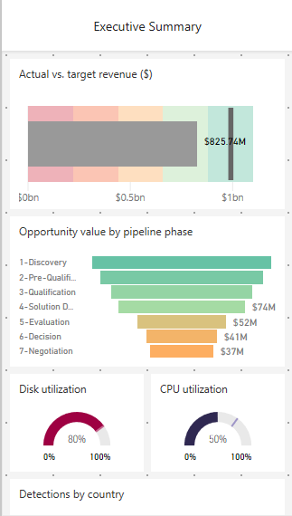
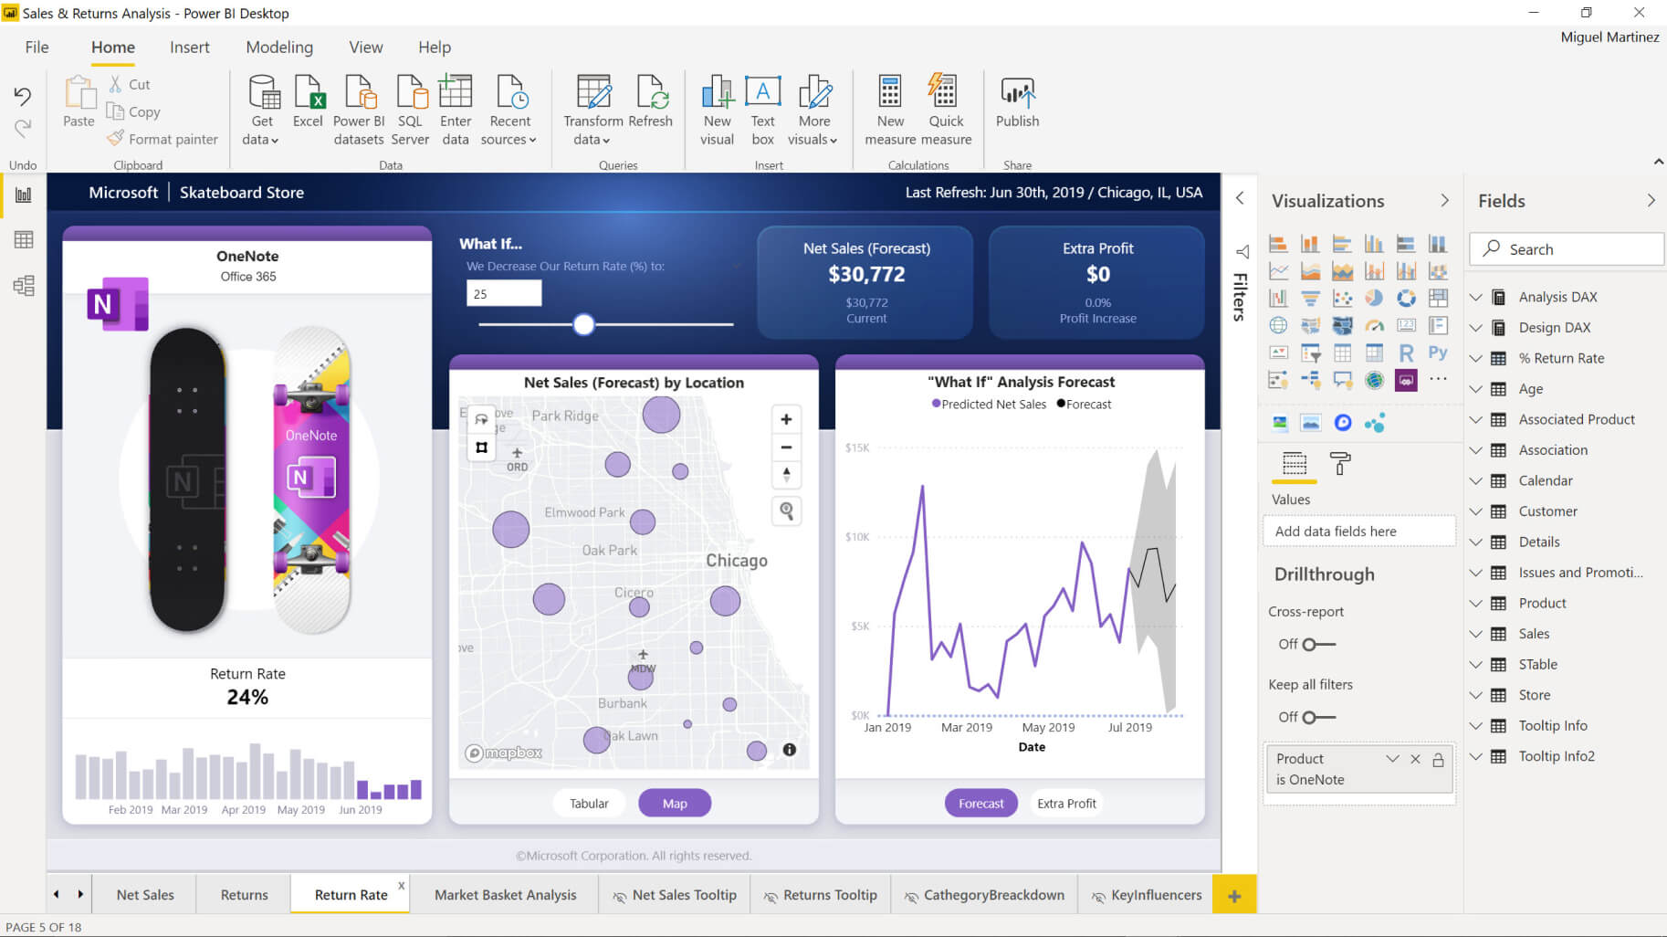
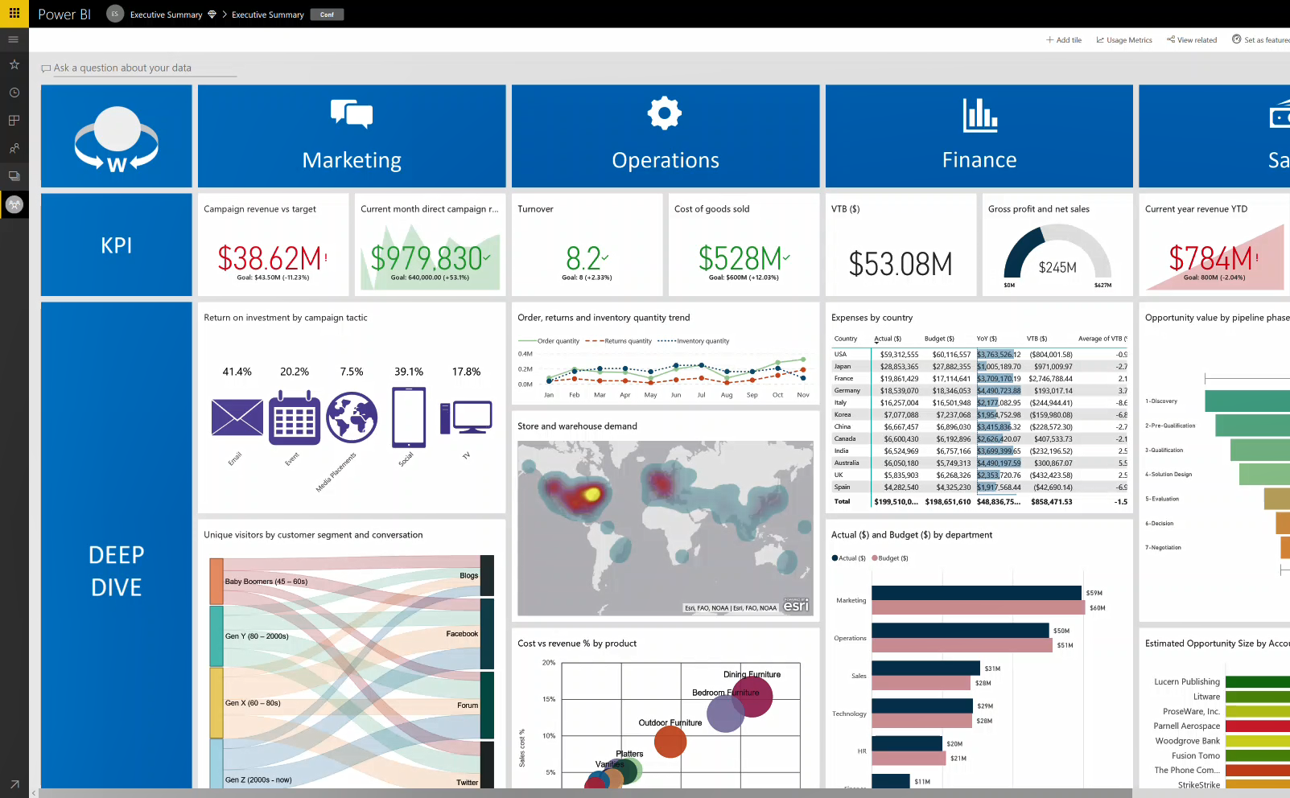
Power BI Overview
Connect to all your data and get a consolidated view across your business through a single pane of glass
Create ad-hoc analysis, live dashboards and interactive reports that are easy to consume on the web and across mobile devices
Build smart apps by infusing insights from your data and drive action with the power of Microsoft Power Platform
Notes:
Power BI (Business Intelligence) is a business analytics service that delivers insights for analyzing data. It can share those insights through data visualizations which make up reports and dashboards to enable fast, informed decisions. Power BI scales across an organization, and it has built-in governance and security allowing businesses to focus on using data more than managing it.
You can consider Power BI as the analysis and insights leg of Microsoft Power Platform. It takes business data and allows you to display it in ways that makes the most sense to users. A Power BI dashboard could potentially replace a standing meeting to report out on company metrics such as sales data, progress against goals, or employee performance.

Slide 11
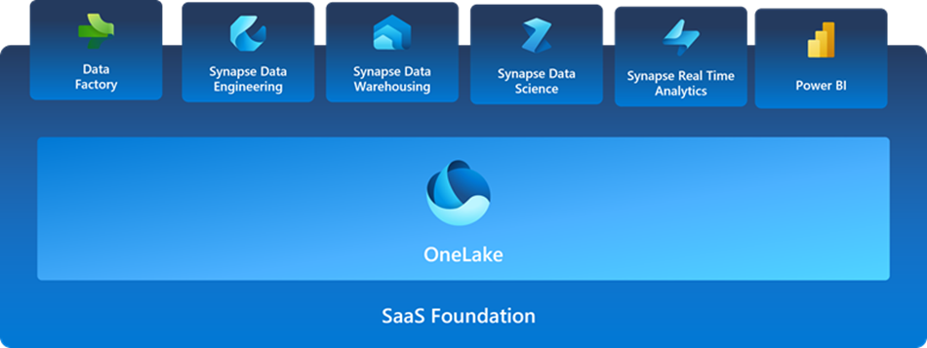
NEW Analytics Stack Microsoft Fabric
Notes:
Microsoft Fabric is an all-in-one analytics solution for enterprises that covers everything from data movement to data science, Real-Time Analytics, and business intelligence. It offers a comprehensive suite of services, including data lake, data engineering, and data integration, all in one place.
Microsoft Fabric's unified management and governance make it easier for data professionals to work together on data projects. Fabric removes data silos and the need for access to multiple systems, enhancing collaboration between data professionals.

Slide 12
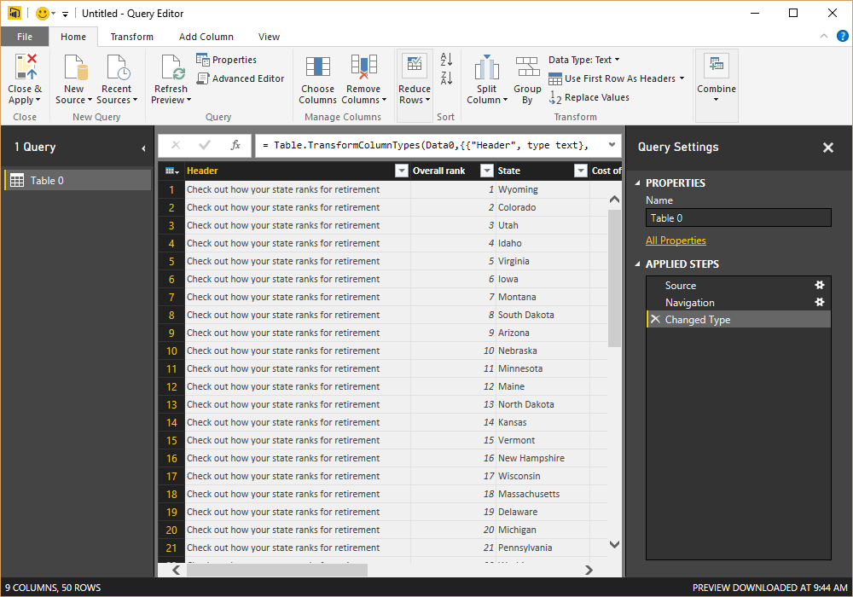
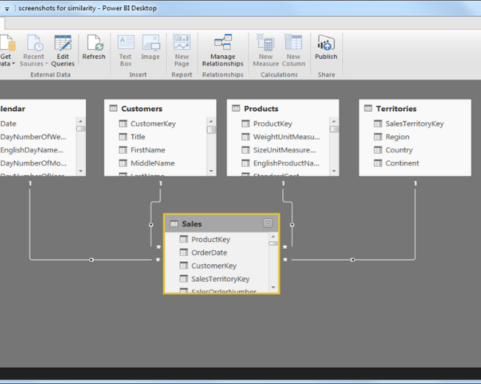
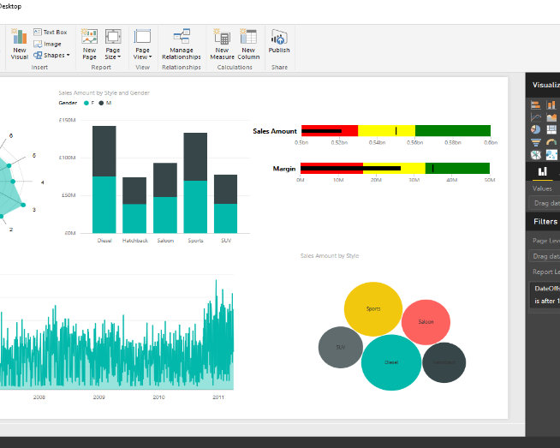
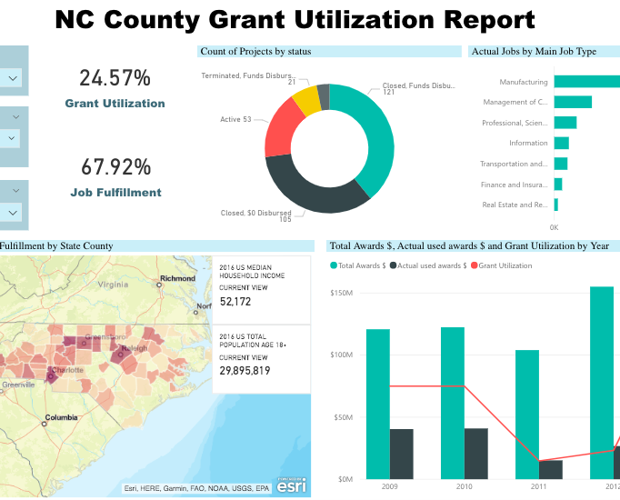
4 Layers of Power BI
Model Developer
Report Developer
Extract, Transform and Load (ETL)
Data Modeling
Report Design
Web Portal

Slide 13


Introduction to the Data Sets
A division of Adventure Works
For our live exercises, we will be using the SuperStore data set. This is a retail business data set that provides us with both facts and dimension tables allowing us to analyze key transactional information regarding the business performance.
Fact Tables
Consumer
Corporate
Home Office
Sales Forecast
Dimension Tables
Category
Sub-Category
Product
Sales Rep
Sales Rep Profile
For the Lab exercises, we will be using the Power Cycle data set. This is a Global fictitious Cycle Retailer and your Job will be to use the data set to complete the lab based on the instructions provided in the lab resource materials.
Fact Tables (Sales Table)
Australia
Canada
France
Germany
UK
US
Power Cycle Target
Dimension Tables
Product Category
Product Sub-Category
Product Sales Region
Salesperson

Slide 14
Introduction to the Lab Exercises
A division of Adventure Works
The data set is from a fictitious cycling retailer with an international footprint. Your goal as the analyst is to use Power BI and DAX calculations to answer key questions about the business including sales trends, top preforming resellers, actual sales vs. budget and segmentation.
There will be a total of 6 Lab to be completed. Each Lab will build upon the previous one
All you’ve been given is a collection of raw csv files containing POS sales records, along with details about the company’s products, customers, locations and employees.
*This data is adapted from Microsoft Adventure works data pack and is for informational purposes only . These samples are provided “as is” without warranty of any kind. The example companies, organizations, products, domain names, email addresses, people, places, and events depicted herein are fictitious, and no association with any real company, organization, product, person, place, or event is intended or should be inferred.

Slide 15
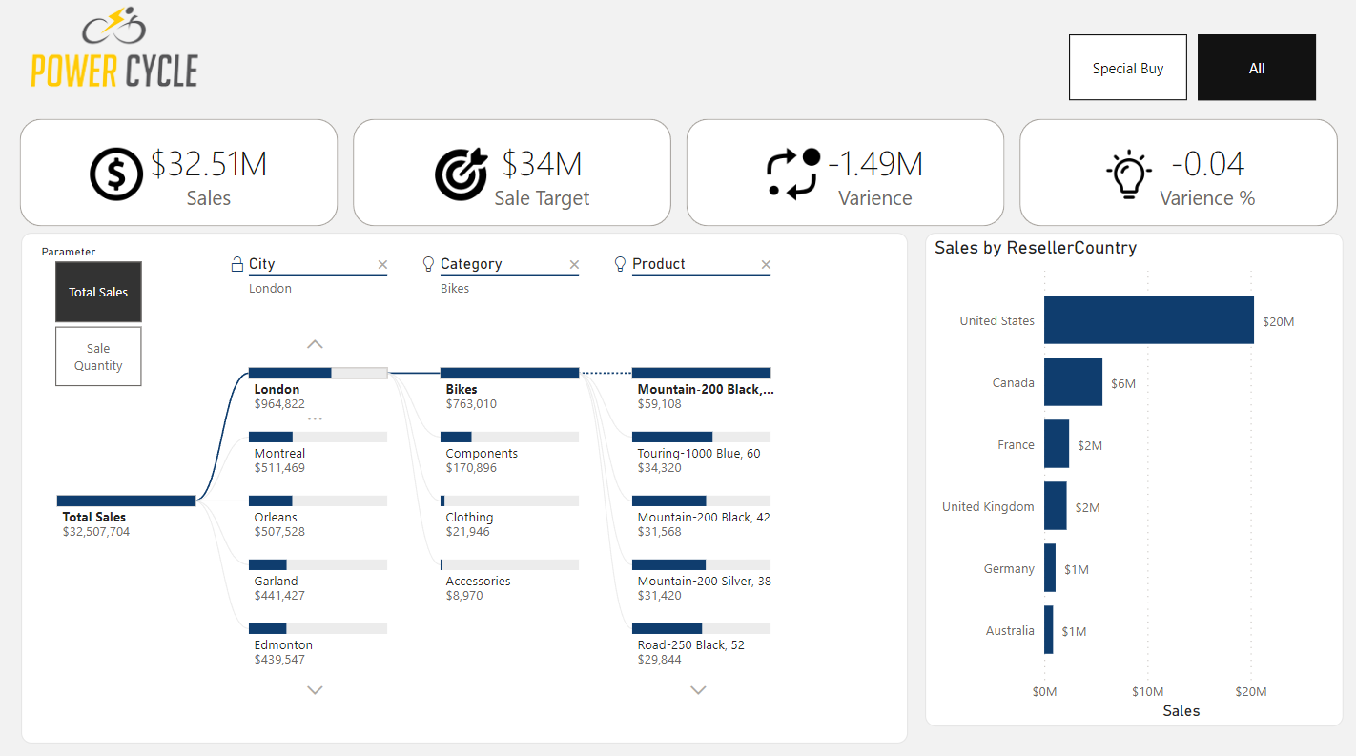
Final Report

Slide 16
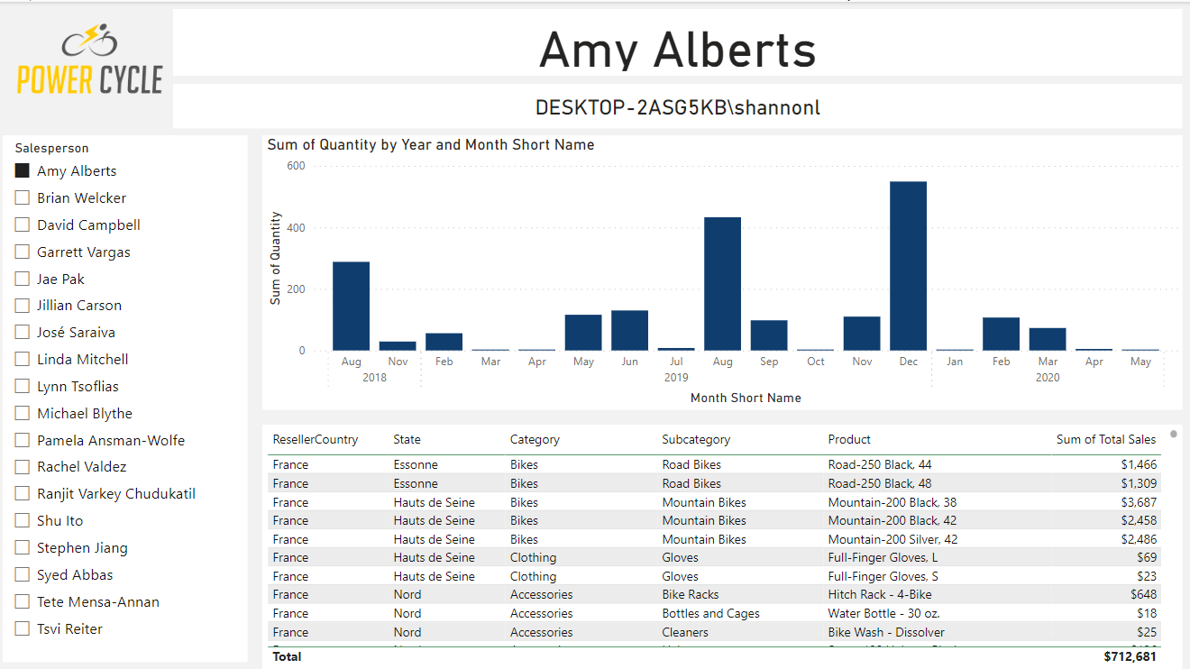
Employee RLS Page

Slide 17
Lesson 1 Getting data from different sources
After completing this module, students will be able to:
Identify and retrieve data from different data sources
Understand the connection methods and their performance implications
Connecting to SharePoint and Power BI services
Understanding storage modes
Notes:
This module explores identifying and retrieving data from various data sources. You will also learn the options for connectivity and data storage and understand the difference and performance implications of connecting directly to data vs. importing it.

Slide 18
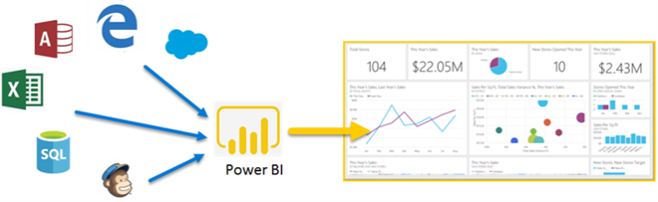
Source Types
Flat File
Relational Data Sources
Non-SQL Data (unstructured)
Online Services
API’s

Slide 19
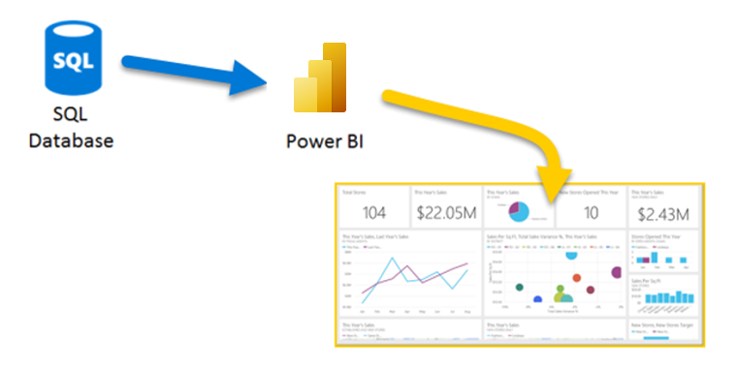
Get data from relational data sources
Notes:
If your organization uses a relational database to record its sales transactions, you can use Power BI Desktop to establish a connection to your organization's relational database, rather than getting data from individual flat files.
Connecting Power BI to your database will help you to monitor the progress of your business and identify trends, so you can forecast sales figures, plan budgets and set performance indicators and targets. Power BI Desktop can connect to many relational databases that are either in the cloud or on-premises.
Connect to the relational data store: Use Get data in Power BI Desktop and select the applicable option for your relational database.
Select the data to import: Select a table or entity to preview its contents and make sure that the correct data will be loaded into the Power BI model.
(Optional) Import data by writing a SQL Query: Another way you can import data is to write an SQL query to specify only the tables and columns that you need.
(Optional) Change data source settings: After you create a data source connection and load data into Power BI Desktop, you can return and change your connection settings at any time.

Slide 20
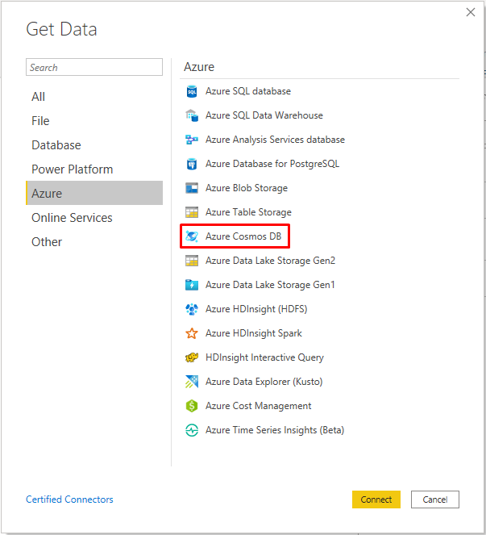
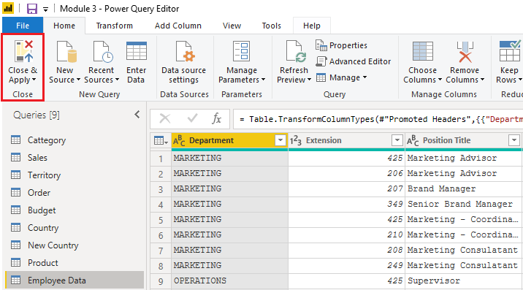
Unstructured Data Source
Notes:
Some organization don't use a relational database but instead use a NoSQL database. A NoSQL database (also referred to as non-SQL, not only SQL or non-relational) is a flexible type of database that does not use tables to store data.
Examples include Azure CosmosDB, Azure Blob/Table storage, MongoDB.
With Power BI and Power Query Editor, you can ingest NoSQL data which resembles a table with rows and columns, and relate that data to other data sources.
Connect to a NoSQL database: In Get Data, select the Azure category, select Azure Cosmos DB,and then select Connect.
Select the data: Select the table that you want to import. The preview pane only shows Record items because all records in the document are JSON documents and represented as a Record type in Power BI.
Review the selected data: To ensure you are satisfied with the data.
The data now resembles a table with rows and columns. Data from Cosmos DB can now be related to data from other data sources and can eventually be used in a Power BI report.

Slide 21
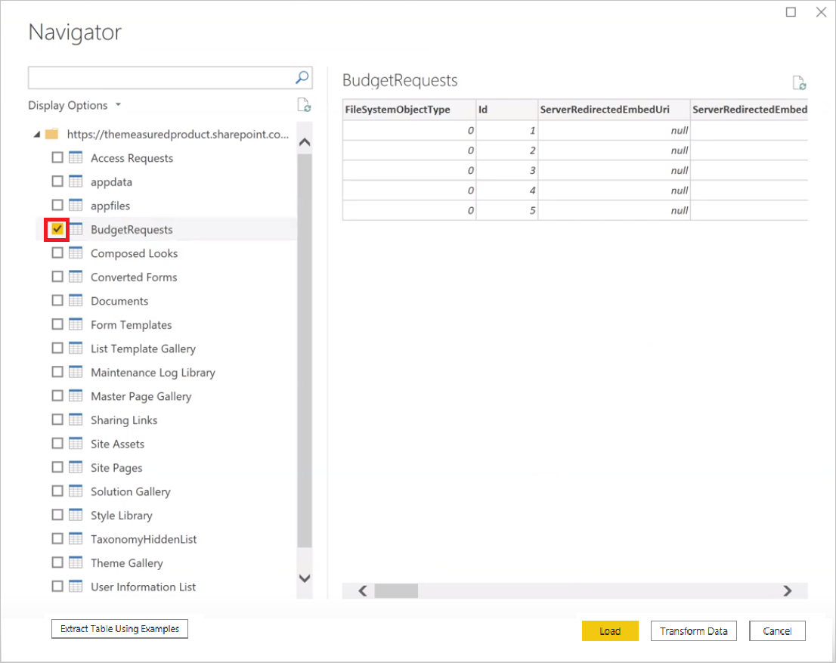
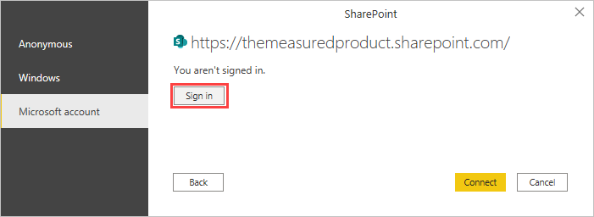
Getting Data From SharePoint
Notes:
To support their daily operations, organizations frequently use a range of software applications, such as SharePoint, OneDrive, Dynamics 365, Google Analytics and so on. These applications produce their own data. Power BI can combine the data from multiple applications to produce more meaningful insights and reports.
When connecting to data in an application, you would begin in the same way as you would when connecting to the other data sources.
Connect to data in an application: Select the Get data feature in Power BI Desktop. Then, select the option that you need from the Online Services category.
Choose the application data to import: Select the list that you want to load into Power BI Desktop. Similar to when you import from other data sources, you have the option to automatically load your data into Power BI model or launch the Power Query Editor to transform your data before loading it.
When you are satisfied with your data, select the Close & Apply button to apply your changes and load your data into Power BI Desktop.

Slide 22
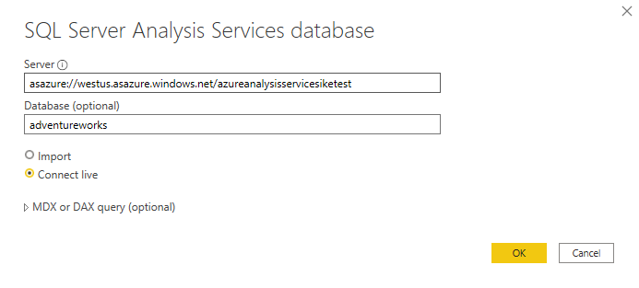
Get data from Analysis Services
An analytical data engine that lets you digest data from multiple data sources and create calculations on the fly.
Notes:
Azure Analysis Services is an Azure product that allows you to ingest data from multiple data sources, build relationships between the data, and creates calculations on the data. The calculations are built using data analysis expressions (DAX). Azure Analysis Services is similar to the data modeling and storage technology in Power BI.
Similar to a relational database, you can choose the tables that you want to use. If you want to directly query the Azure Analysis Services model, you can use DAX or MDX.
Notable differences between Azure Analysis Services cubes and SQL Server are:
Analysis Services cubes have calculations already in the cube, which will be discussed in more detail later.
If you don't need an entire table, you can query the data directly. Instead of using Transact-SQL (T-SQL) to query the data, like you would in SQL Server, you can use multi-dimensional expressions (MDX) or data analysis expressions (DAX).
You don't need to use the Get Data button in Power BI Desktop.
Connect live is a new option in Azure Analysis Services. Azure Analysis Services uses the tabular model and DAX to build calculations, similar to Power BI.
Because you want to get data to other data in your organization , you will likely import the data directly into Power BI. An acceptable alternative is to import all other data that you want (from Excel, SQL Server, and so on) into the Azure Analysis Services model and then use a live connection. Using this approach, the data modeling and DAX measures are all performed in one place, and it's a much simpler and easier way to maintain your solution.

Slide 23
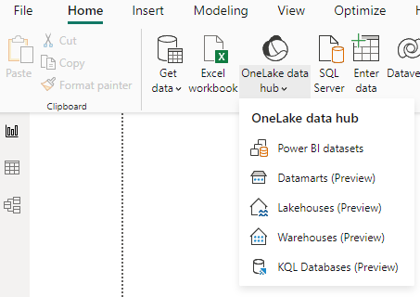
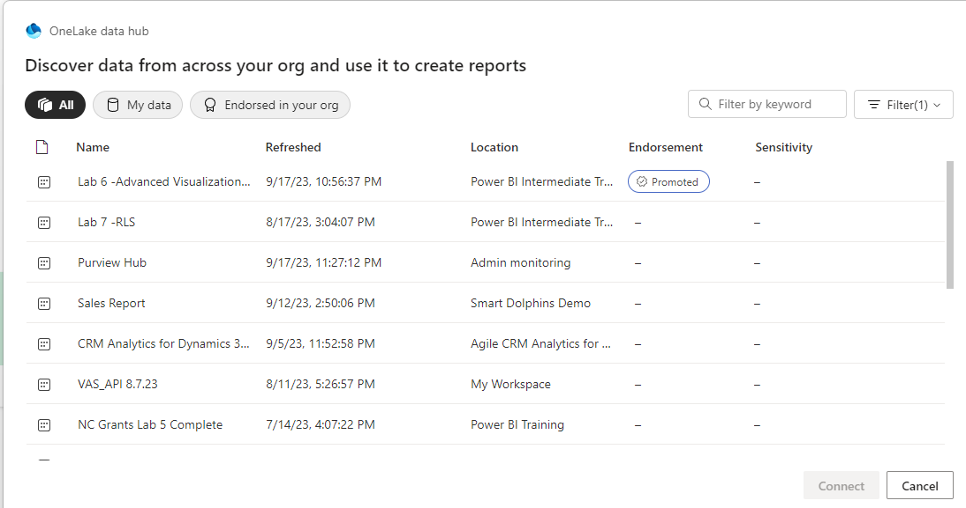
Power BI Published Dataset

Slide 24
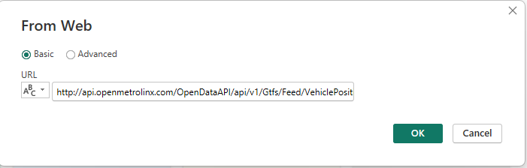
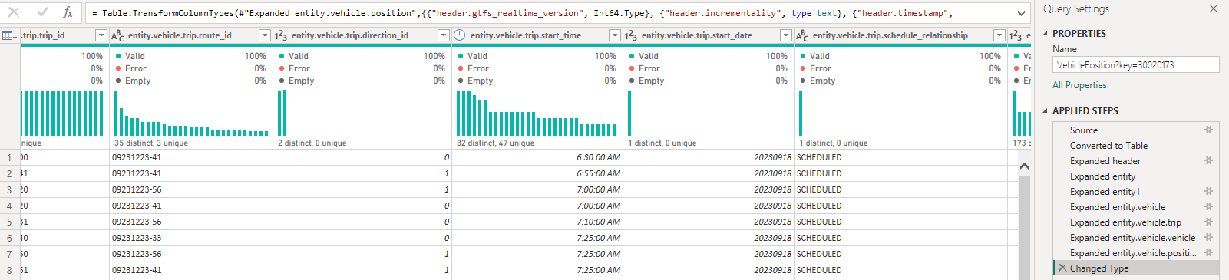
Web Services & API’s
Notes:
Data from API’s are typically transforms from JSON format into data tables in Power BI

Slide 25
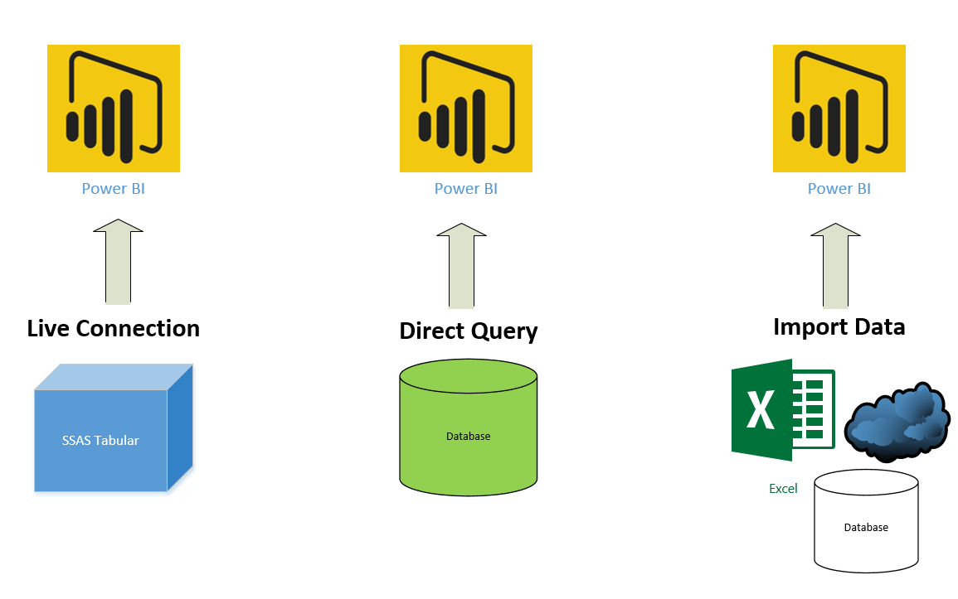
Storage Modes
The three different types of storage modes you can choose from:
Import
DirectQuery (Small data size)
Dual (Composite)
Notes:
The most popular way to use data in Power BI is to import it into a Power BI dataset. Importing the data means that the data is stored in the Power BI file and gets published along with the Power BI reports. This process helps make it easier for you to interact directly with your data. However, this approach might not work for all organizations.
The three different types of storage modes you can choose from:
Import: The Import mode allows you to create a local Power BI copy of your datasets from your data source.
DirectQuery: Create a direct connection to the data source, ensuring your data is not cached and you are always viewing the most up-to-date data.
Dual (Composite): Identify some data to be directly imported and other data that must be queried.
However, sometimes there may be security requirements around your data that make it impossible to directly import a copy. Or your datasets may simply be too large and would take too long to load into Power BI, and you want to avoid creating a performance bottleneck. Power BI solves these problems by using the DirectQuery storage mode, which allows you to query the data in the data source directly and not import a copy into Power BI. DirectQuery is useful because it ensures you are always viewing the most recent version of the data.
Using the Dual mode allows Power BI to choose the most efficient form of data retrieval.
You can set the storage mode for each table individually in your model. This action enables a single dataset, which provides the following benefits:
Query performance
Data refresh optimization

Slide 26
Implications of using DirectQuery
Benefits
Frequently changing data
Need near real-time
Large data volumes
Multi-dimensional data
Limitations
Performance: Dependent on the underlying data source
Security: Understand how data moves between source and destination
Modeling: Some modeling capabilities are limited or aren’t supported
Transformation: Some data transformation techniques are limited

Slide 27
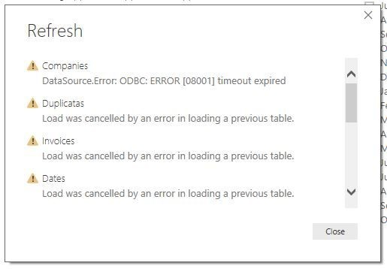
Dealing with Import Errors
When loading your data, you may encounter the following errors:
Query Timeout
Couldn’t find data formatted as a table
Could not find file
Data type errors

Slide 28
Chat Question
What are some common data import errors do you encounter when creating reports?

Slide 29
Optimize Query Performance
Performance in Power Query depends heavily on the performance at the data source.
Follow performance tuning guidelines of the source product.
Some performance tuning can be done in Power BI.

Slide 30
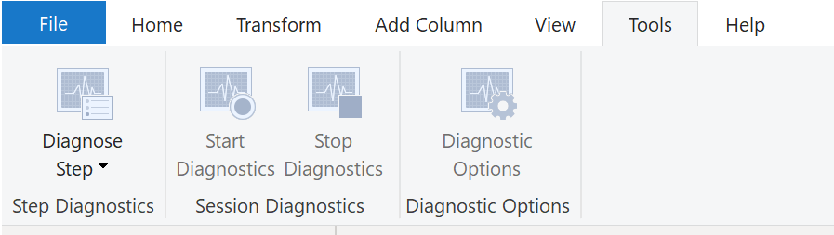
Fix Performance Issues
Notes:
Occasionally, organizations will need to address performance issues when running reports. Power BI provides the Performance Analyzer tool to help fix problems and streamline the process.
Consider the scenario where you are building reports for the Sales team in your organization. You've imported your data, which is in several tables within the Sales team's SQL database, by creating a data connection to the database through DirectQuery. When you create preliminary visuals and filters, you notice that some tables are queried faster than others, and some filters are taking longer to process compared to others.
Query diagnostics
Another tool that you can use to study query performance is query diagnostics. This feature allows you to determine what bottlenecks (if any) exist while loading and transforming your data, refreshing your data in Power Query, running SQL statements in Query Editor, and so on.
Other Techniques:
Process as much data as possible in the original data source.
Use native SQL queries.
Separate date and time, if bound together.

Slide 31
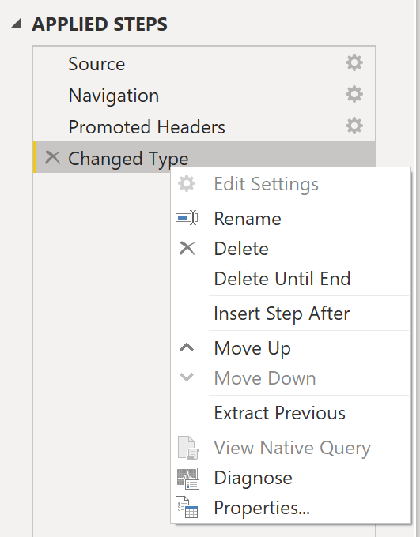
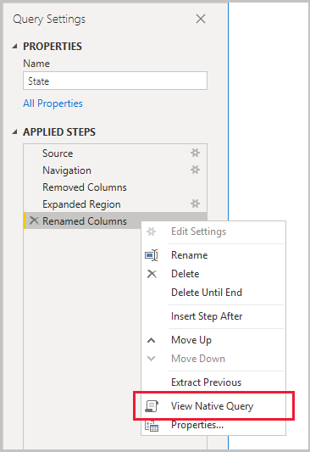
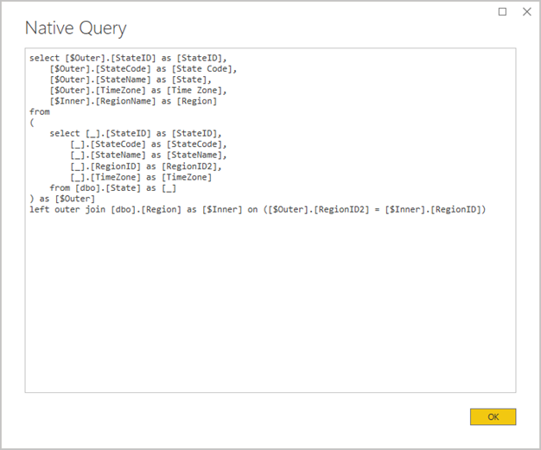
Query Folding
The process that lets Power Query generate a single query statement to retrieve and transform source data.
Notes:
The query folding within Power Query Editor helps you increase the performance of your Power BI reports. Query folding is the process by which the transformations and edits that you make in Power Query Editor are simultaneously tracked as native queries, or simple Select SQL statements, while you are actively making transformations. The reason for implementing this process is to ensure that these transformations can take place in the original data source server and do not overwhelm Power BI computing resources.
You can use Power Query to load data into Power BI. Using Power Query Editor you can then make further transformations to your data, such as renaming or deleting columns, appending, parsing, filtering, or grouping your data.
The benefits to query folding include:
More efficiency in data refreshes and incremental refreshes. When you import data tables by using query folding, Power BI is better able to allocate resources and refresh the data faster because Power BI does not have to run through each transformation locally.
Automatic compatibility with DirectQuery and Dual storage modes. All DirectQuery and Dual storage mode data sources must have the back-end server processing abilities to create a direct connection, which means that query folding is an automatic capability that you can use. If all transformations can be reduced to a single Select statement, then query folding can occur.
If the View Native Query option is not available (not displayed in bold type), that query folding is not possible for this step, and you will have to work backward in the Applied Steps area until you reach the step in which View Native Query is available (displays in bold type). This process will reveal the native query that is used to transform the dataset.
Native queries are not possible for the following transformations:
Adding an index column
Merging and appending columns of different tables with two different sources
Changing the data type of a column
Running complex DAX functions

Slide 32
Knowledge Check 1

Slide 33
Lesson 2 Clean Transform, Load the Data
After completing this module, students will be able to:
Apply data shape transformations
Enhance the structure of the data
Profile and examine the data

Slide 34
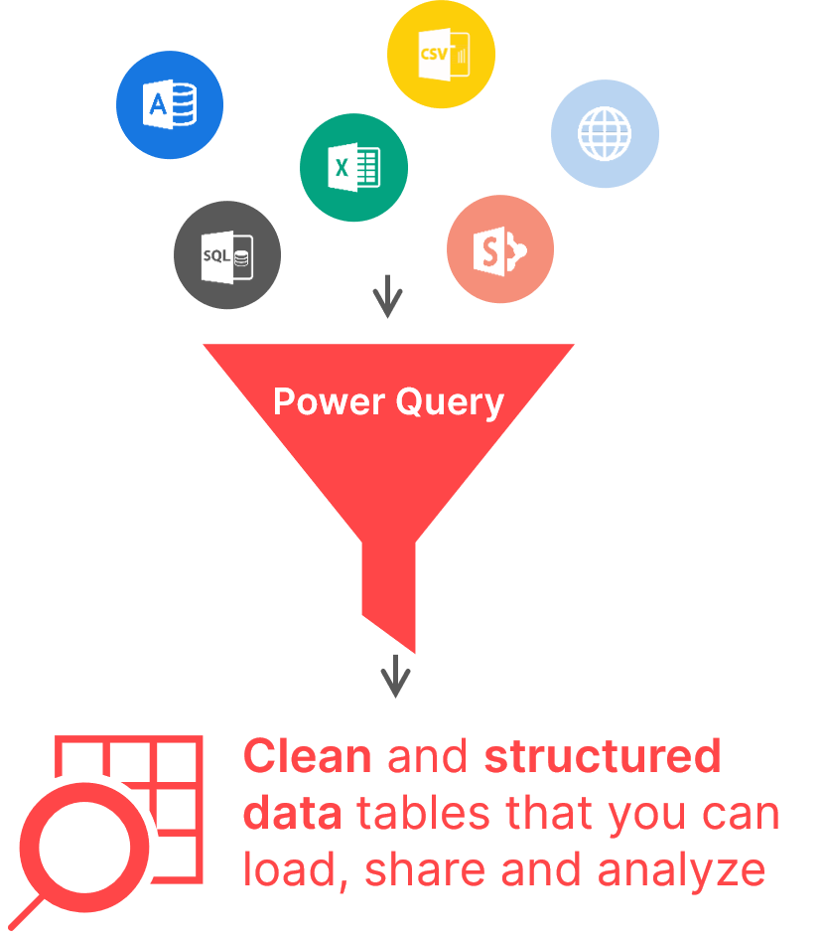
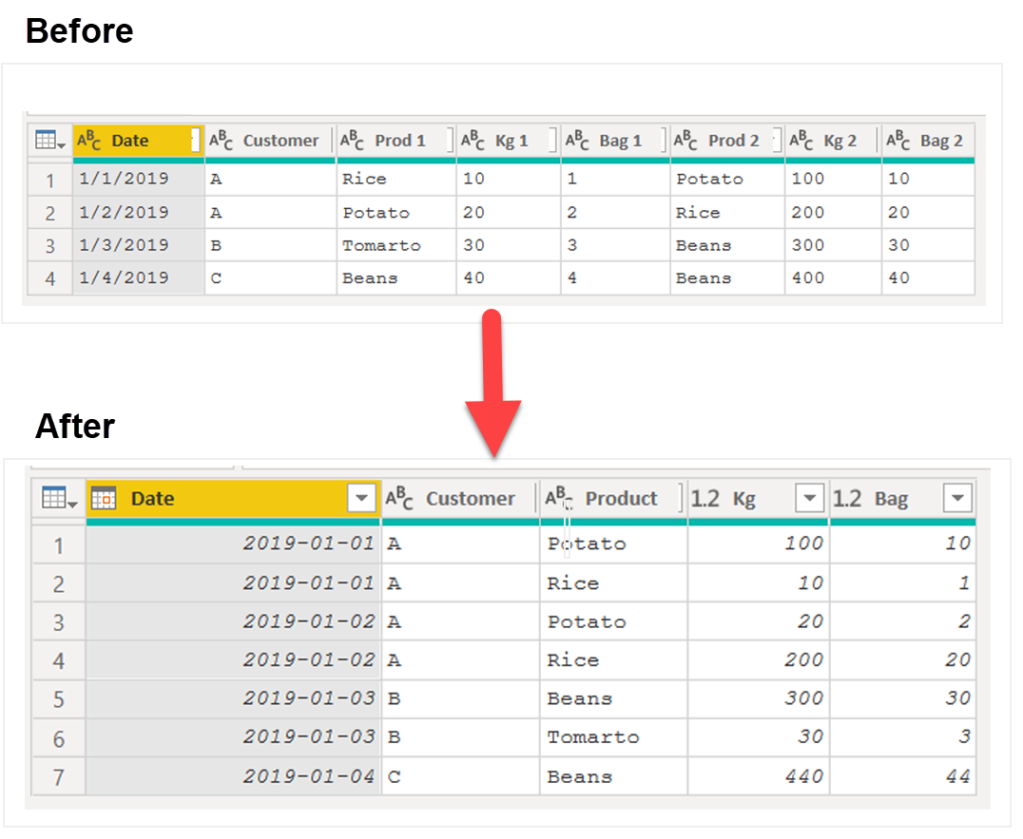
Power Query Editor
Notes:
Power Query Editor in Power BI Desktop shapes imported data by renaming columns or tables, converting text to numbers, removing rows, setting headers, and more.
Shaping data is essential for meeting your needs and creating suitable reports.
Data from two sources, a manual .csv file created in Excel by the Sales team and data from the organization's ERP system, has been loaded into the Power BI model. The data appears disorganized in Power BI Desktop, with unnecessary data and incorrect formats.
To prepare for report building, utilize Power Query Editor to clean and shape the data.

Slide 35
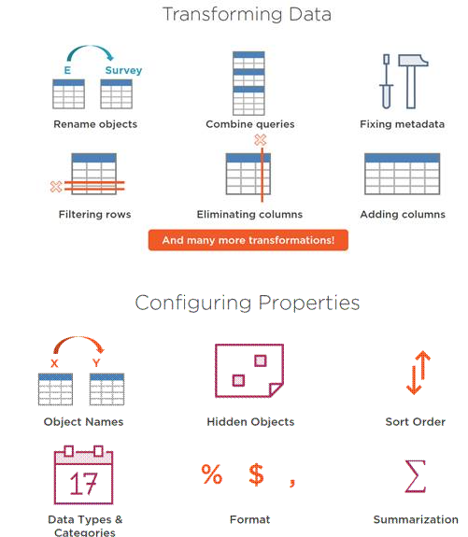
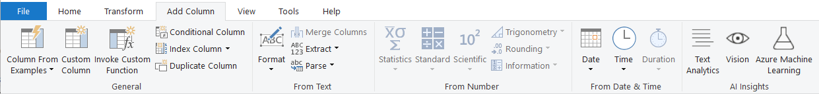
ETL Tools & Utility
Data Transformation
Property Configuration
Notes:
ETL – Extract, Transform,Load
Common actions performed in Power Query Editor include tasks like renaming columns, removing unnecessary ones, and applying formatting, which can all be found in the Transform ribbon. While we won't cover all these actions here, we recommend exploring them to familiarize yourself with the available options.
To start shaping your initial data, your first step should involve identifying column headers and names in your dataset and ensuring their correct placement.
Additionally, you have the capability to:
Add columns based on existing ones
Create custom columns using the M language
Convert date/time columns to calculate age, years, and more.
Use "Choose columns" or "Go to Column" to select the specific columns you need, and avoid retaining unnecessary ones. If you're working with date/time data but only require the date or time portion, adjust the data type accordingly to optimize your dataset's size.
Remember that when you explicitly choose columns, your selections remain unaffected by any new columns added to the underlying dataset. This differs from merely removing a column by name. Always double-check and ensure correct data types after completing column transformations.

Slide 36
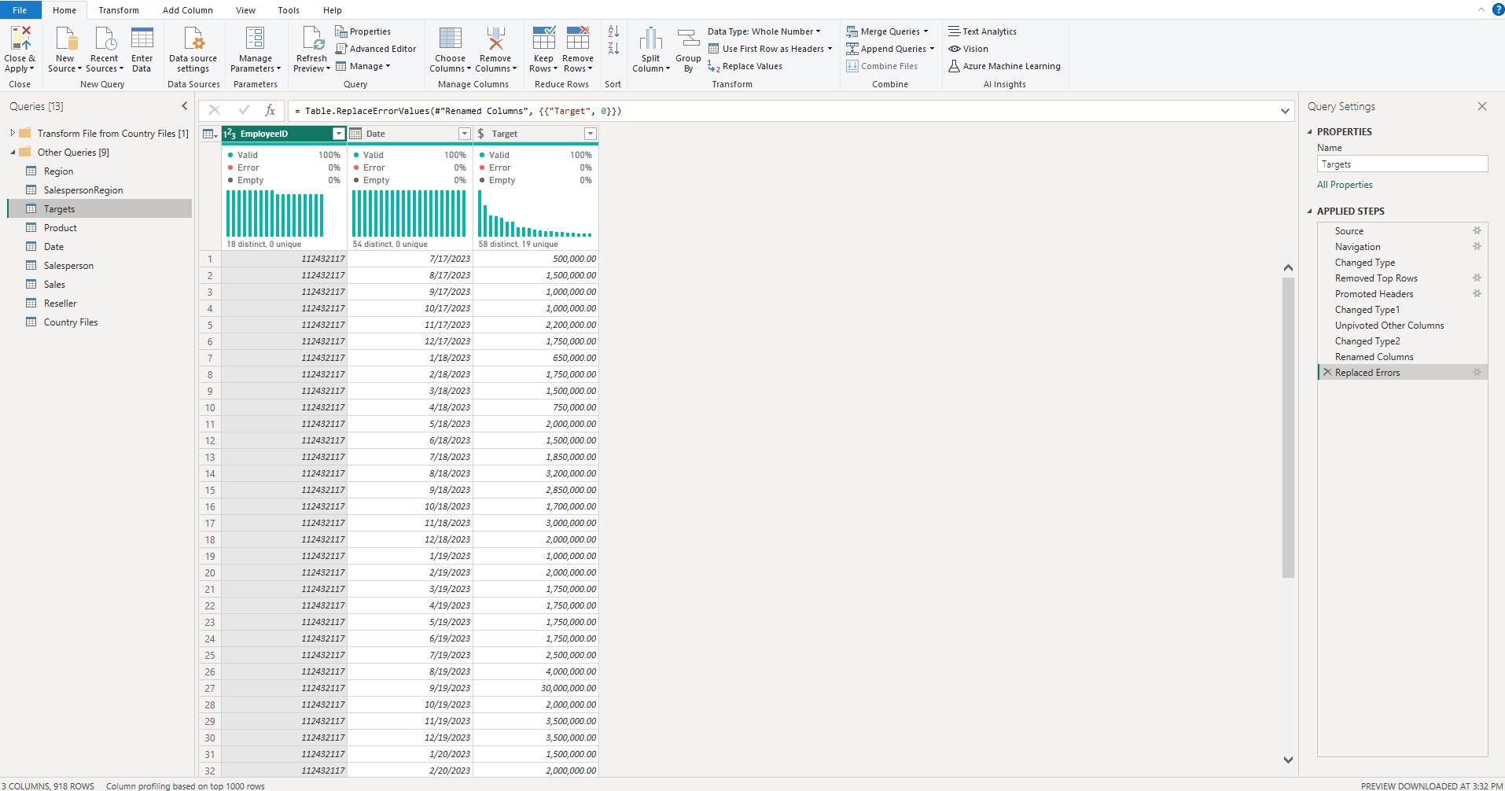
Power Query Interface
In the ribbon, buttons are active to interact with the data in the query
The Query Settings window appears, listing the query’s properties and applied steps
Queries are listed and available for selection, viewing, and shaping
In the center pane, data from the selected query is displayed and available for shaping
Notes:
Ribbon: the ribbon navigation experience, which provides multiple tabs to add transforms, select options for your query, and access different ribbon buttons to complete various tasks.
Queries pane: a view of all your available queries.
Current view: your main working view, that by default, displays a preview of the data for your query. You can also enable the diagram view along with the data preview view. You can also switch between the schema view and the data preview view while maintaining the diagram view.
Query settings: a view of the currently selected query with relevant information, such as query name, query steps, and various indicators.
Status bar: a bar displaying relevant important information about your query, such as execution time, total columns and rows, and processing status. This bar also contains buttons to change your current view.

Slide 37
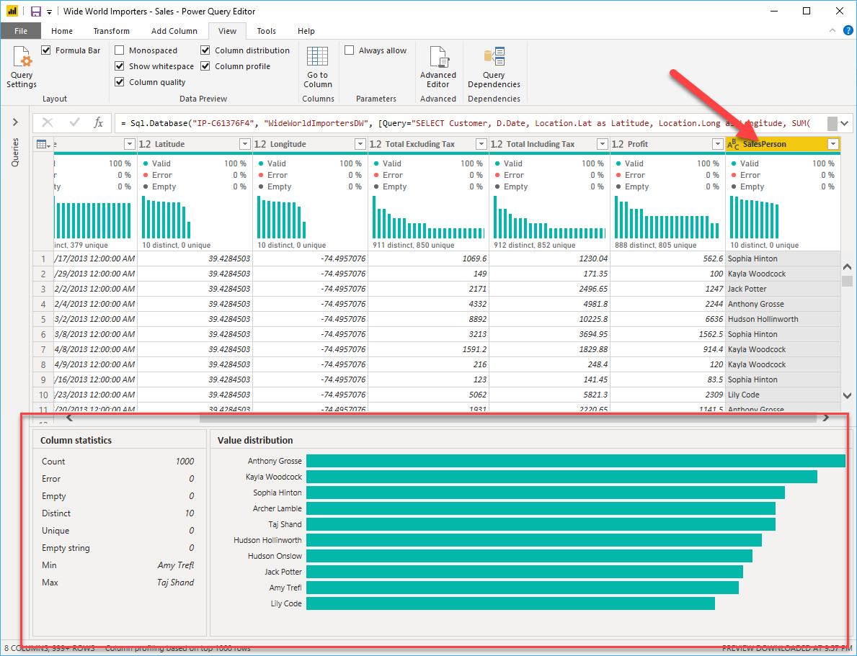
Find data anomalies and data statistics
Data profiling entails studying data nuances, detecting anomalies, exploring underlying structures, and querying statistics like row counts and value distributions.
This is crucial for simplifying data interaction and streamlining the development of report elements on the frontend.
Note: Data Preview is based on the first 1,000 rows
Notes:
Understanding Data Structures:
Before delving into data exploration in Power Query Editor, it's essential to grasp the fundamental data structures underlying the organization of your data. Profiling your data can occur either prior to or in tandem with the data transformation process. An important aspect of this understanding involves identifying related tables, which is crucial for configuring relationships during the subsequent data modeling phase.
Identifying Data Anomalies and Gathering Data Statistics:
Once you've established a connection to your data source and entered the Transform Data stage in Power Query Editor, you have the opportunity to detect any irregularities or anomalies within your dataset. Data anomalies refer to data points that deviate significantly from the norm within your dataset.
Within this context, you can utilize several tools:
Column Distribution: This tool provides insights into how data is distributed within a specific column.
Column Profile: For a more in-depth analysis of a column's content, including basic statistical information, you can refer to the Column Profile.
Value Distribution Graph: This graphical representation illustrates the frequency of each unique value within a particular column.
Column Statistics: This feature offers valuable information such as the count of zero and null values, the column's average value, standard deviation, and even the count of even and odd values present in the column.

Slide 38
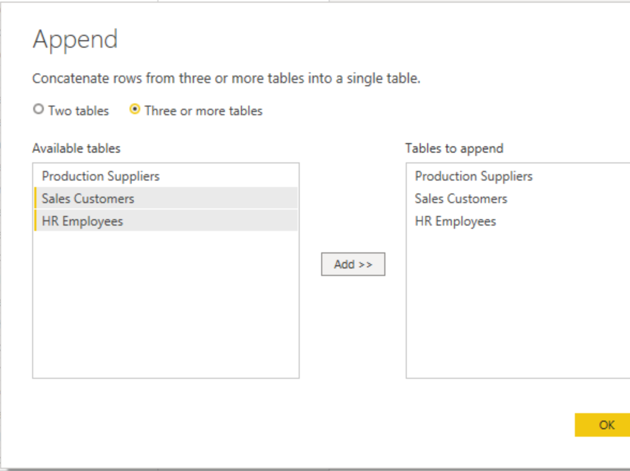
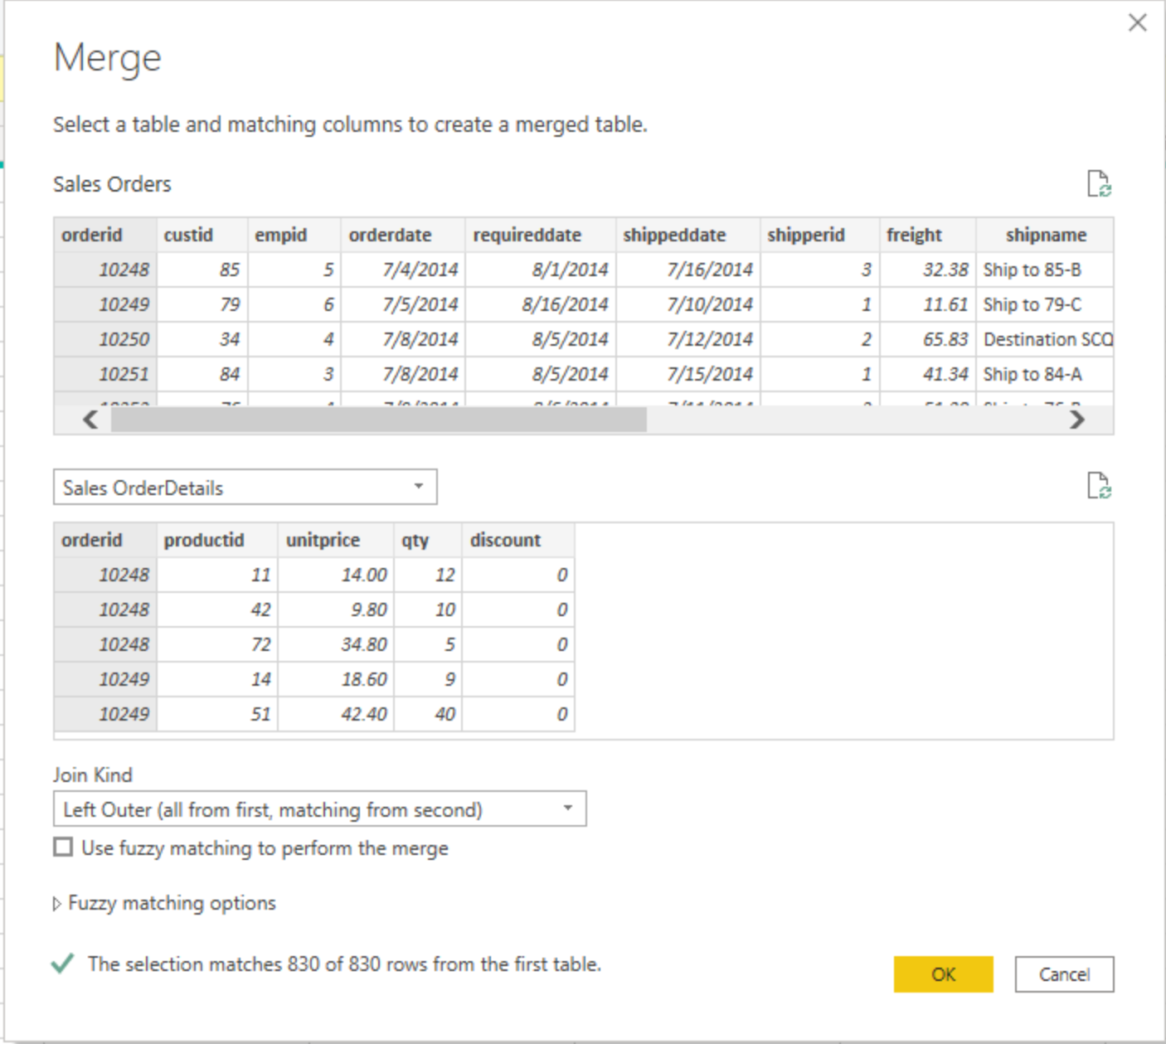
Combine multiple queries into one
Notes:
The capability to merge queries is a potent tool as it empowers you to combine or consolidate various tables or queries. You might find it advantageous to merge tables under the following circumstances:
When you have an excessive number of tables, leading to a convoluted data model that's challenging to navigate.
When multiple tables serve a similar purpose or role.
When a table contains just a few columns that could better fit within a different table.
When you need to utilize several columns from different tables to create a custom column.
Merging tables can be accomplished in two ways: through merging and appending.
Appending:
When you append queries, you effectively add rows of data from one table or query to another. For instance, if you have one table with 300 rows and another with 100 rows, appending queries results in a combined table of 400 rows. It's important to note that appending queries does not eliminate duplicates.
In cases where the columns in the source queries don't precisely match, appending still functions. However, it creates a new column in the output for each distinct column. If one of the source queries lacks a particular column, the cell values for that column in those rows will be null.
Merging:
Merging queries entails the consolidation of data from multiple tables based on a common column shared among them. This process resembles the JOIN clause in SQL, where you incorporate columns from one table (or query) into another. To merge two tables successfully, there must be a key column that links the two tables.
Furthermore, you have the flexibility to choose how to join these tables, similar to using JOIN statements in SQL. Your join options encompass:
Left Outer: Displays all rows from the first table and only the matching rows from the second.
Full Outer: Displays all rows from both tables.
Inner: Displays only the matched rows between the two tables.

Slide 39
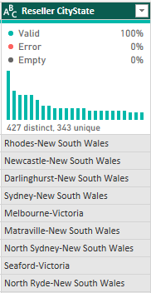
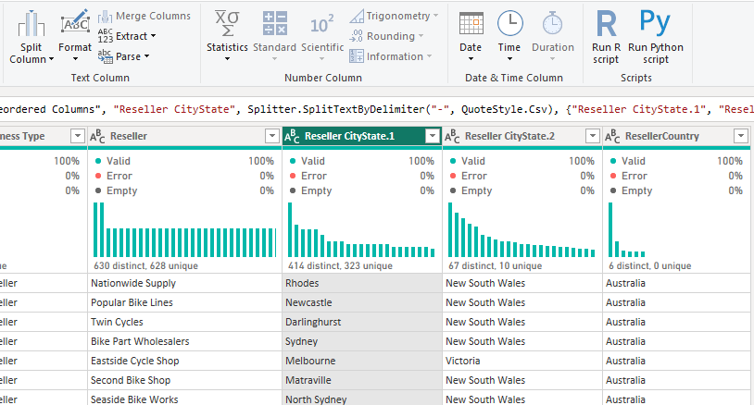
Splitting Columns
To split columns in Power Query, first, select the column you want to divide. Then, use the "Split Column" function and specify whether you want to split by a delimiter (like a comma or space) or by a fixed number of characters.
Notes:
The "Split Column" feature in Power Query lets you divide a single column of data into multiple columns, either by specifying a delimiter or a fixed number of characters. It's a handy tool for reorganizing data to suit your analysis or reporting requirements. Simply select the column, choose the split method, customize options if needed, preview the results, and then load the transformed data.

Slide 40
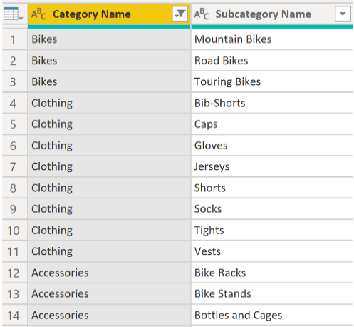
Unpivot columns or pivot
Notes:
Unpivoting Columns:
When we perform the operation of unpivoting a table, what we essentially do is take all the distinct rows found in the "category name" column and transform them into individual columns.
Unpivoting is a valuable functionality within Power BI, applicable to data from various sources, although it's most commonly employed when working with imported data from Excel. Unpivoting simplifies the process of later creating DAX measures with the data. By executing this operation, it helps streamline the subsequent steps.
In situations where the data you are shaping lacks structure and is considered flat (meaning it contains a lot of detail but isn't organized or grouped), it can be challenging to identify data patterns. To address this, you can utilize the "Pivot Column" feature to convert your flat data into a structured table that presents aggregate values for each unique value within a specific column.
Pivoting Columns:
Similarly, if you are dealing with flat data that lacks organization or grouping, the absence of structure can complicate the task of recognizing data patterns.
To overcome this challenge, you can employ the "Pivot Column" feature, which allows you to transform your flat data into a table presenting aggregate values for each distinct value within a given column. For example, you might utilize this feature to summarize data using various mathematical functions such as Count, Minimum, Maximum, Median, Average, or Sum

Slide 41
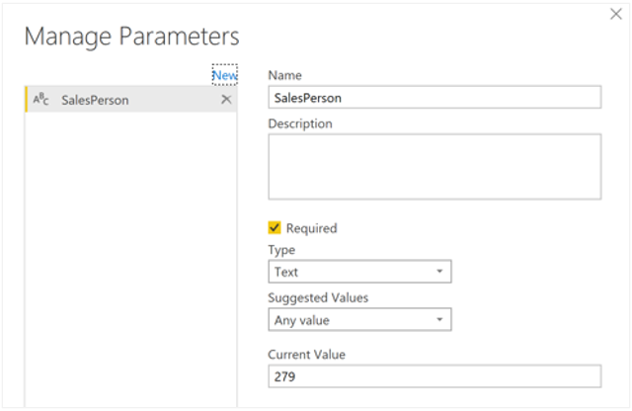
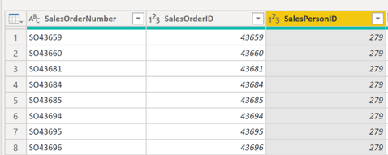
Dynamic reports with parameters
Notes:
Utilizing parameters involves specifying the desired data values for the report, resulting in the report dynamically adjusting to filter the data accordingly.
Consider a sales analysis report as an example, where setting a parameter for the salesperson ID serves to enable personalized analysis for different sales representatives.
By establishing a parameter for the salesperson ID, users gain the capability to choose a specific salesperson from a dropdown menu or slicer within the Power BI report. Subsequently, this chosen parameter value is employed in Power Query to filter the sales data, ensuring that only transactions linked to the selected salesperson are included. This functionality empowers users to concentrate on individual sales performance, perform comparisons among salespeople, and obtain insights into their distinct contributions to overall revenue and customer acquisition.

Slide 42
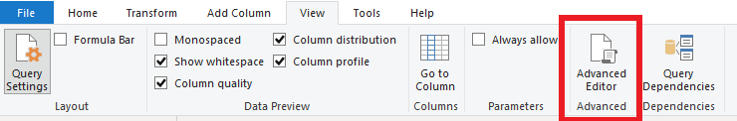
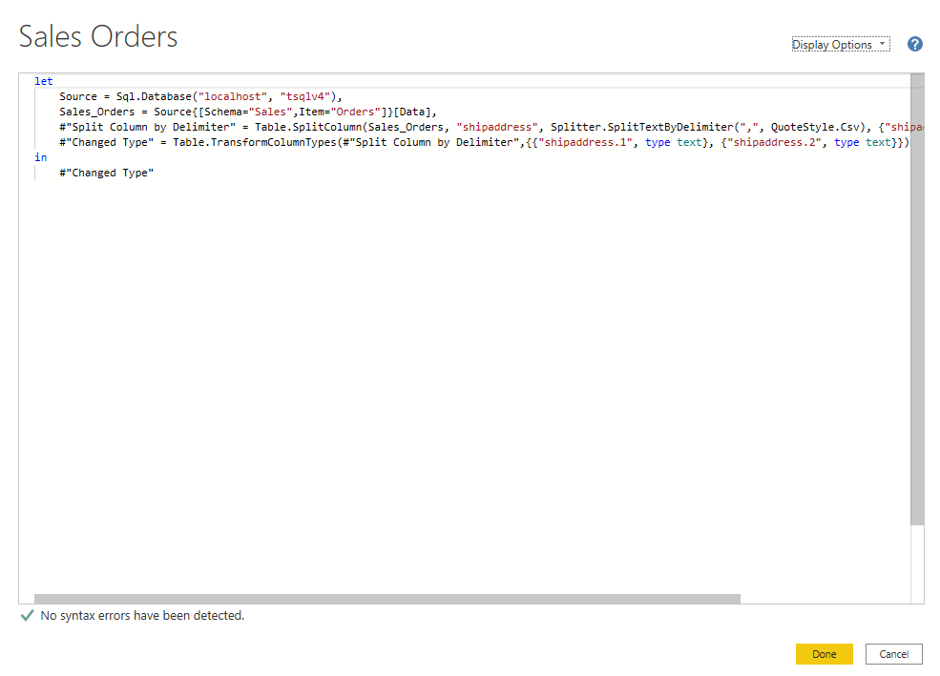
Use Advanced Editor to modify M code
When shaping data in Power Query, each action creates a step in the process that can be reordered, deleted, or modified.
While the graphical interface is commonly used, Power Query operates with the underlying M language.

Slide 43

Data reduction best practices
Remove unnecessary columns
Remove unnecessary rows
Group by and summarize
Optimize column data types
Preference for custom columns
Disable Power Query load
Disable auto date/time
Switch to Mixed mode (Composite model)

Slide 44
Live Demo

Slide 45
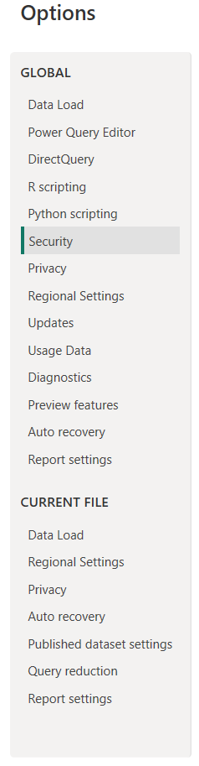
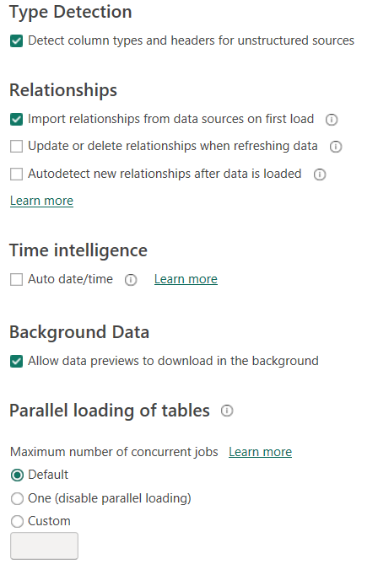
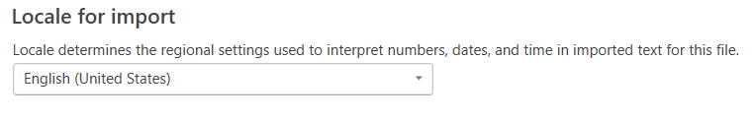
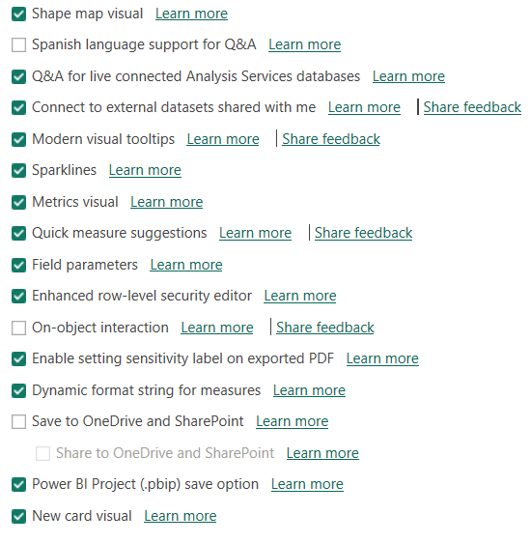
Power BI Options & Settings
Data Load
Regional Settings
Preview Features
Notes:
1)In the “Preview Features” tab, deselect any active features while you are taking this course
2)In the “Data Load” tab, deselect the “Update Relationships”, “Autodetect new relationships after data is loaded” and “Auto date/time” options
3)In the “Regional Settings” tab, make sure to use the “English (United States)” locale for import
NOTE: You may need to update settings in both the Current File and Global sections

Slide 46
Power Cycle Lab Exercise 1

Slide 47
Knowledge Check 2

Slide 48

Summary and Q&A
Today, we learned how to :
Get data from different sources
Clean Transform & Load Data
In the next session, we will learn how to:
Design a Data Model
Create Model Calculations using DAX

Slide 49
Power BI Intermediate
Day 2

Slide 50
Warm up
Take a few minutes and draft a "tweet" of less than 280 characters that summarizes what you learned in the previous sessions.
Share it in the chat box (and on Twitter, too, if you like!)
Notes:
The purpose of this activity is to warm-up the class with a fun exercise.
The instructor should COMMENT on themes about what people want to learn and ASK additional questions to draw out details.

Slide 51
Design a Data Model
Create Model Calculations using DAX
Notes:
The purpose of this slide is to indicate the start of the section.

Slide 52
Lesson 3 Design a Data Model
After completing this module, students will be able to:
Define relationships and their cardinality
Implement Dimensions and Hierarchies
Understanding filter propagation

Slide 53
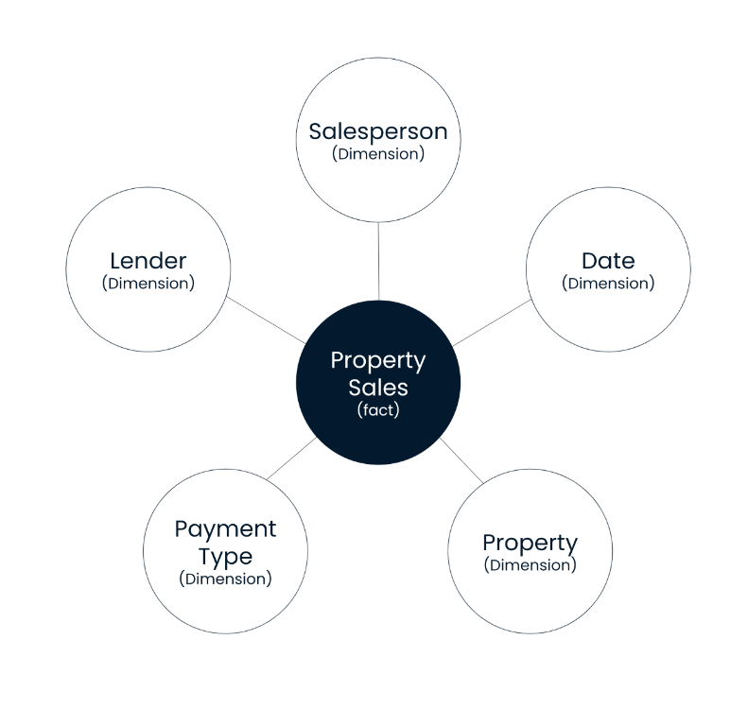
STAR SCHEMA
Fact tables contain observational or event data values: sales orders, product counts, prices, transactional dates and times, and quantities.
Dimension tables contain the details about the data in fact tables: products, locations, employees, and order types. These tables are connected to the fact table through key columns. Dimension tables are used to filter and group the data in fact tables
Notes:
You can design a star schema to simplify your data. It's not the only way to simplify your data, but it is a popular method; therefore, every Power BI data analyst should understand it. In a star schema, each table within your dataset is defined as a dimension or a fact table, as shown in the following visual.

Slide 54
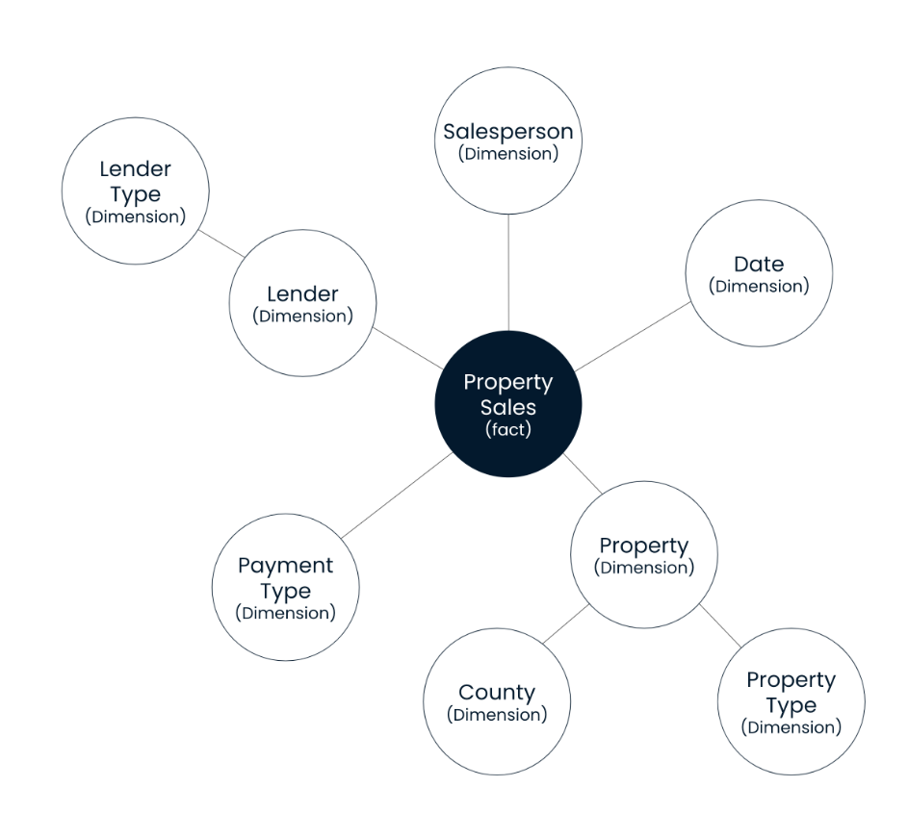
Snowflake Schema
Snowflake schema allows relationships between dimensions and differs from the star schema in that it has more Hierarchies between tables.
Notes:
You can design a star schema to simplify your data. It's not the only way to simplify your data, but it is a popular method; therefore, every Power BI data analyst should understand it. In a star schema, each table within your dataset is defined as a dimension or a fact table, as shown in the following visual.

Slide 55
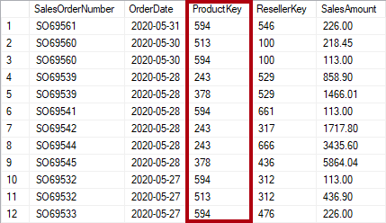
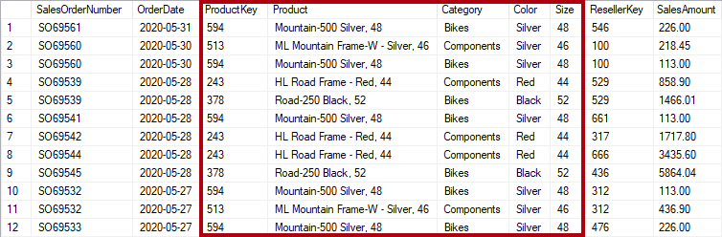
Table Normalization
Notes:
Database normalization is the process used to organize a database into tables. In a way that eliminates redundant data and improves data integrity. The basic idea is that each table should be about a specific topic.

Slide 56
COMPARE FACT AND DIMENSION TABLES
Characteristic | Dimension table | Fact table
Model purpose | Stores business entities | Stores events or observations
Table structure | Includes a key column and descriptive columns for filtering and grouping | Includes dimension key columns and numeric measure columns that can be summarized
Data volume | Typically, contains fewer rows (relative to fact tables) | Can contain numerous rows
Query purpose | To filter and group | To summarize

Slide 57
Relationship & Cardinality
Each model relationship is defined by a cardinality type. There are four cardinality-type options, representing the data characteristics of the "from" and "to" related columns. The "one" side means the column contains unique values; the "many" side means the column can contain duplicate values.
One-to-one (1:1)
One-to-many (1:*) Many-to-one (*:1)
Many-to-many (*:*)
Notes:
Cardinality refers to the uniqueness of values in a column
For our purposes, all relationships in the data model should follow a “one-to-many” cardinality; one instance of each primary key, but potentially many instances of each foreign key

Slide 58

One-to-many (1:*) Many-to-one (*:1)
The one-to-many and many-to-one cardinality options are essentially the same, and they're also the most common cardinality types meaning there should be a single instance of each primary key while potentially accommodating multiple instances of each foreign key.
Notes:
One-to-many relationships are valuable in Power BI, they should be used wisely and with careful consideration of their potential impact on complexity, performance, and data integrity. Properly defined and maintained, these relationships can help you represent and analyze your data effectively.

Slide 59

One-to-one (1:1)
Maintaining one-to-one relationships may lead to redundant data storage since the tables involved often contain overlapping information. This redundancy can increase memory usage and make the data model more challenging to manage.
Notes:
one-to-one relationships are typically avoided in Power BI because they can add unnecessary complexity and reduce flexibility. Instead, consider merging tables when appropriate to simplify your data model and potentially improve performance.

Slide 60


Many-to-many (*:*)
A many-to-many relationship means both columns can contain duplicate values. This cardinality type is infrequently used. It's typically useful when designing complex model requirements.
Notes:
Imagine a situation where your assignment involves creating a visual representation to analyze budget data related to customers and accounts. Given that there can be multiple customers associated with the same account, and vice versa, it becomes evident that you must establish a many-to-many relationship to accurately model this scenario.
Avoiding many-to-many relationships in Power BI is advisable because they can introduce complexity and potential issues into your data model. Here are a few reasons why you should be cautious with many-to-many relationships:
Ambiguity: Many-to-many relationships can create ambiguity when querying the data. Aggregations and calculations may not yield clear or expected results, making it challenging to draw meaningful insights.
Performance Impact: They can negatively impact query performance, as Power BI may need to process multiple intermediate tables to resolve the relationships. This can lead to slower report rendering and longer refresh times.
Maintenance Complexity: Managing many-to-many relationships requires careful consideration and maintenance. Changes to the data model or relationships can be more challenging to implement and troubleshoot.
Potential Data Integrity Issues: Many-to-many relationships can lead to data integrity problems, such as duplicate or incorrect results. It's crucial to be vigilant in ensuring data accuracy.
Alternative Solutions: In many cases, you can achieve the same analytical goals using alternative modeling techniques, like bridging tables, without resorting to many-to-many relationships. These methods can often provide a clearer and more efficient way to structure your data.

Slide 61

Inactive Relationships
Inactive relationships in Power BI are relationships between tables that are temporarily turned off for filtering and calculations to avoid conflicts in data analysis.
They can be activated as needed for specific tasks.
Notes:
Inactive relationships in Power BI refer to relationships between tables in a data model that are not actively used for filtering or calculations in a report. These relationships are typically created to support specific scenarios, like solving circular dependencies, but are marked as inactive to prevent unintended consequences in your data analysis. Inactive relationships can be activated when needed, providing flexibility in building complex data models without compromising performance or data accuracy.

Slide 62

Filter Propagation
Notes:
A model relationship propagates filters applied on the column of one model table to a different model table. Filters will propagate so long as there's a relationship path to follow, which can involve propagation to multiple tables.
Relationship paths are deterministic, meaning that filters are always propagated in the same way and without random variation. Relationships can, however, be disabled, or have filter context modified by model calculations that use particular DAX functions.

Slide 63


CROSS FILTER DIRECTION
Each model relationship is defined with a cross-filter direction. Your setting determines the direction(s) that filters will propagate. The possible cross-filter options are dependent on the cardinality type.

Slide 64




Filter Flow Example
To filter both facts tables correctly the ProductKey from the Dimension table must be used for the correct results
Notes:
In this case, the only valid way to filter both Internet Sales and Reseler Sales data byProduct key is to use the ProductKey field from the DimProduct table, which is upstream and related to both data tables

Slide 65
DATA MODEL BEST PRACTICES
Use a star schema with
Contain relationships with one way filters (vs. bidirectional)
Contain tables that each serve a specific purpose, including data (fact) tables and lookup (dim) tables
Only include the data you need for analysis (no redundant or unnecessary records or fields)
Split out individual date and time components from DateTime fields

Slide 66
Live Demo

Slide 67
Power Cycle Lab Exercise 2

Slide 68
Knowledge Check 3

Slide 69
Lesson 4 Create Model Calculations using DAX
After completing this module, students will be able to:
Understand DAX functions
Creating a calculated Data table using DAX
Use DAX for formulas and expressions
Create calculated tables and measures
Build dynamic measures

Slide 70

DAX (Data Analysis Expressions)
DAX can be used to create three types of calculations:
Calculated table
Calculated column
Measure
DAX can also be used to define row-level security (RLS) rules
Notes:
DAX (Data Analysis Expressions) is used in Microsoft Power BI to enable advanced data modeling, analysis, and calculations. With DAX, you can create calculated columns, measures, and custom tables that go beyond simple aggregations. It offers a rich set of functions, operators, and constants to perform complex calculations, data transformations, and business logic. DAX allows users to create powerful formulas and expressions that unlock deeper insights, enable dynamic reporting, and support sophisticated data analysis scenarios in Power BI.

Slide 71
Common DAX Functions
Math & Stats
Logic
Text
Filter
Time Intelligence
Common Examples:
Common Examples:
Common Examples:
Common Examples:
Common Examples:
SUM
AVERAGE
MAX/MIN
DIVIDE
COUNT/COUNTA
COUNTROWS
DISTINCTCOUNT
IF
IFERROR
AND
OR
NOT
SWITCH
TRUE
FALSE
CONCATENATE
FORMAT
LEFT/MID/RIGHT
UPPER/LOWER
PROPER
LEN
SEARCH/FIND
REPLACE
REPT
SUBSTITUTE
TRIM
UNICHAR
CALCULATE
FILTER
ALL
ALLEXCEPT
RELATED
RELATEDTABLE
DISTINCT
VALUES
EARLIER/EARLIEST
HASONEVALUE
HASONFILTER
ISFILTERED
USERELATIONSHIP
TOTALMTD
TOTALQTD
TOTALYTD
SAMEPERIODLASTYEAR
PARALLELPERIOD
DATESBETWEEN
DATEADD
DATESINPERIOD
SUMX
AVERAGEX
MAXX/MINX
COUNTX

Slide 72

Common DAX Operators
Notes:
All comparison operators, except strict equal to (==), treat BLANK as equal to the number zero, an empty string (""), the date December 30, 1899, or FALSE.
It means that the expression [Revenue] = 0 will be TRUE when the value of [Revenue] is either zero or BLANK. In contrast, [Revenue] == 0 is TRUE only when the value of [Revenue] is zero.

Slide 73
Standard Aggregation Measures
Typically, numeric columns are summarized using aggregation functions.
Common examples of summarizing:
Sum
Count
Average
Min and Max
Column references always enclose the column name in square brackets
Total Sale = sum('Sales By Country Files’[Sales])
Sale Quantity = Average('Sales By Country Files'[Quantity])

Slide 74

DAX Calculated column
A Calculated column adds a new column to a table
A formula is evaluated for each row in the table
The formula must return a single value
It is only evaluated when the model is refreshed*
It increases the storage size of the model*
*Except when added to a DirectQuery table
Notes:
A calculated column formula must return a scalar or single value.
Calculated columns in import models have a cost:
They increase the model storage size and they can prolong the data refresh time.
The reason is because calculated columns recalculate when they have formula dependencies to refreshed tables.

Slide 75

DAX Calculated measures
A Measure summarizes model data
The formula must return a single value
It is evaluated at query-time
Results are never stored in the model

Slide 76
Calculated columns vs. measures
There are differences between calculated column and measure
 | Calculated Columns | Measures
Purpose | Extend table | Summarize model data
Evaluation | Row context at data refresh-time | Filter context at query-time
Storage | Stores value in each table row | Never stores value
Visual use | Filter, group, or summarize | Designed to summarize
Notes:
The purpose of Calculated columns is to summarize model data.

Slide 77
Implicit & Explicit Measures
 | Benefits | Limitations
Implicit Measures | Accessible to non-technical users. Enables self-service analytics. Easy to modify and adjust. | Limited flexibility for complex calculations. Limited control and customization May lack granularity and detailed data analysis capabilities.
Explicit Measures | Greater flexibility and customization Requires deeper understanding of DAX and the data model. Can be used in Analyze with Excel export option | Requires advanced technical knowledge of DAX. Time-consuming to create and manage complex calculations. Excessive use can impact report performance.

Slide 78

Understand context when using DAX
How context affects DAX measures is a difficult concept to comprehend. The ensuing visuals will demonstrate how context affects DAX measures so you can see how they interact together.
The following three visuals use the exact same DAX measure: Total Sales.

Slide 79

DAX Formatting
From
USSales = CALCULATE([Total Sales],FILTER(Reseller,Reseller[ResellerCountry]= "United States“))
To
USSales =
CALCULATE (
[Total Sales],
FILTER ( Reseller, Reseller[ResellerCountry] = "United States" )
)
Use shift + enter to split out and indent each component of your DAX formulas to make them more readable
https://www.daxformatter.com/
Notes:
Consider the top measure definition that's written in a single line and that includes 2 DAX function calls
The following example is the same measure definition but now formatted, which helps make it easier to read and understand:
When you add a carriage return, remember to press the Shift+Enter shortcut keys.
Tip:
An excellent formatting tool from another source that can help you format your calculations is DAX Formatter .
The tool allows you to paste in your calculation and format it.
Then, you can copy the formatted calculation to your clipboard and paste it back into Power BI Desktop.
Formatting Benefits
Readability
Debugging ease
Maintenance efficiency
Collaboration support
Self-documentation
Potential performance improvements

Slide 80
Formula Commenting
Sales Previous Year % Change =
var CY = [Total Sales] // Current Year Sales
var PY = [Sales Last Year] // Last Years Sales
RETURN
DIVIDE(CY-PY,PY)
Comment Type | Marker
Single Line Comment | -- or //
Multi Line Comment | /* … */
Adding comments to your code can assist fellow users in understanding your script, and this practice proves especially beneficial for intricate queries featuring numerous lines and nested functions.
Notes:
Avoid putting comments at the end of your DAX query (below the last closing parenthesis), as they can be missed or omitted by users and formatting tools

Slide 81
Using Variables
Variables can be defined in an expression to make writing DAX easier
Main benefits:
Improves readability of a formula
Improves performance when an expression is used multiple times
Allows testing portions of a complex formula, by returning only a variable for review
VAR = <name> RETURN <result_expression>
Example:
VAR RevenuePriorYear = CALCULATE( [Revenue], SAMEPERIODLASTYEAR('Date'[Date]) )
RETURN
DIVIDE( [Revenue Measure] -RevenuePriorYear, RevenuePriorYear )
Notes:
Variables in DAX are placeholders for values or expressions that you can use within a DAX formula. They improve code readability, simplify complex calculations, and enhance performance by storing intermediate results. Variables make DAX formulas more understandable and maintainable, especially in scenarios where you need to reuse the same value or sub-expression multiple times in your calculations.
VAR = Declaration of the variable with an assigned name
Return = results

Slide 82

DAX Quick Measures
Power BI Desktop supports creating
Quick Measures
Benefits:
Quick and easy
Common calculation templates are available
Automatically creates the DAX expression
No need to understand any DAX
Once created, they are like any other explicit measure
To modify the measure, simply edit the formula

Slide 83


DAX Quick Suggestion AI generation (New)
Quick measure suggestions assist in creating DAX measures using natural language instead of templates or writing DAX from scratch.

Slide 84
Iterator functions
Iterator functions enumerate all rows of a given table and evaluate a given expression for each row
They provide flexibility over how calculations summarize data
All iterator functions require Table and Expression
The expression must return scalar or single value
Iterator functions are easily identified by the appended “X”
For example:
Common aggregation: SUMX, AVERAGEX, COUNTX, MINX, and MAXX
Special: CONCATENATEX, and RANKX
Notes:
DAX includes a set of functions known as iterator functions.
Iterator functions enumerate all rows of a given table and evaluate a given expression for each row. They provide you with flexibility and control over how your model calculations will summarize data.
By now, you're familiar with single-column summarization functions, including SUM, COUNT, MIN, MAX, and others. Each of these functions has an equivalent iterator function that's identified by the "X" suffix, such as SUMX, COUNTX, MINX, MAXX, and others.
Additionally, specialized iterator functions exist that perform filtering, ranking, semi-additive calculations over time, and more.
Characteristic of all iterator functions, you must pass in a table and an expression. The table can be a model table reference or an expression that returns a table object. The expression must be evaluated to a scalar value.

Slide 85
Iterator functions example
Measure = SUMX( <Table>, <Expression> )
Revenue = SUMX( Sales, Sales[Order Quantity] * Sales[Unit Price] )
Notes:
This is what the signature of a common iterator function (SUMX) looks like.
Now, consider the example of the Revenue measure. It iterates each row of the Sales table (in filter context) and multiplies the Order Quantity column by the Unit Price column.
Finally, it sums all row calculations together to produce total revenue.

Slide 86

Iterator functions example
10.38
80.76
419.46
874.79
809.76
714.70
1,429.40
…
∑
208,202.17

Slide 87


Automatic Date Table
By default, Power BI automatically generates a concealed date table for any table that includes a Date or DateTime column on one side of a relationship.
These automatically generated calendars encompass all dates up to the end of the year, irrespective of the actual date range within the table.
Automatically created a hidden date table in the background containing all these columns

Slide 88


PROS & CONS AUTOMATIC DATE TABLES
PROS
Cons
Automatically generated
No code or additional table required
Built-in date Hierarchies aren’t automatically generated
Hidden background table that not be modified
Inflates the Power BI file size due to every date field in your table having a auto-date table
Not a centralized date dimension table
Notes:
Recommendation is to Turn OFF the auto date/time feature in Power BI Desktop and either import a date or create a date table using DAX

Slide 89
Date Dimension Table Requirements Checklist
It should encompass all days corresponding to the years presented in your fact tables.
It is necessary to designate at least one field as a Date or DateTime data type.
Duplicate dates or datetime values are not permissible.
If utilizing a time component within a date column, all times must be uniform (e.g., 12:00 PM).
While not mandatory, it is recommended to label it as a date table for optimal use.
Notes:
Important Note: Time should always be split from the date into a new column as this will facilitate relationship connection requirement

Slide 90

CALENDAR Function
Returns a table with one column of all dates between start and end date
Dates can also be referenced from date fields in other tables as seen in example 2
=CALENDAR(StartDate,EndDate)
Example 1: CALENDAR DATE( 2020,01,01), DATE (2023,12,31)
Example 2: CALENDAR
DATE( YEAR ( MIN (Sales [Order Date] )), 1,1)
DATE( YEAR ( MAX (Sales [Order Date] )), 12,31)

Slide 91

CALENDARAUTO Function
Returns a table with one column of dates based on a fiscal year end month
Range of dates is calculated automatically based on data in the model
Example 1: CALENDARAUTO(4)
Example 2: Calendar Table =
VAR MinYear = YEAR( MIN( ‘Country’[Total Sales]))
VAR MaxYear= YEAR( MAX(‘Country’[Total Sales]))
RETURN
FILTER(CALENDARAUTO(),
YEAR( [Date] ) >= MinYear&&YEAR( [Date] ) <= MaxYear)
=CALENDARAUTO(FiscalYearEndMonth)

Slide 92


The Date Dimension Table
Column Name | Function
DAX Defined Date | Dates = CALENDAR(DATE(2011, 5, 31), DATE(2022, 12, 31))
DAX Auto Date | Dates = CALENDARAUTO()
DAX Year | Year = YEAR(Dates[Date])
DAX Month | MonthNum = MONTH(Dates[Date])
DAX Week number | WeekNum = WEEKNUM(Dates[Date])
DAX Day of the week | DayoftheWeek = FORMAT(Dates[Date], "DDDD")
Notes:
Date dimension table….During report creation in Power BI, a common business requirement is to make calculations based on date and time. Organizations want to know how their business is doing over months, quarters, fiscal years, and so on. For this reason, it is crucial that these time-oriented values are formatted correctly. Power BI autodetects for date columns and tables; however, situations can occur where you will need to take extra steps to get the dates in the format that your organization requires.

Slide 93

Formatting your date
By using the DAX FORMAT function to specify date/time formatting you can specify the format output you would like for your fields.
FORMAT(<value>, <format_string>[, <locale_name>])
Code | Description
dddd | Display the full day name
ddd | Display the short day name
mmmm | Show full month name
mmm | Show abbreviated month name
mm | Display the month as a two digit number
q | Display the quarter of the year
yyyy | Show the year as a four digit number
Short Month Name = FORMAT('Table'[Date],"mmm")

Slide 94

Marking Date Dimension Table
To use the Time Intelligence functions, a table must be marked as a date table
It also allows the model tables to use a non-date type key
The date key can be in ISO format, for example, 20210630
Multiple model tables can be marked as date tables
Notes:
To use the Time Intelligence functions, a table must be marked as a date table.
Multiple model tables can be marked as date tables. (Not Mandatory)
For more information, see https://docs.microsoft.com/power-bi/guidance/model-date-tables

Slide 95
Live Demo

Slide 96
Power Cycle Lab Exercise 3

Slide 97
Knowledge Check 4

Slide 98
Summary and Q&A
Today, we learned how to:
Design a Data Model
Create Model Calculations using DAX
In the next session, we will learn about:
CALCULATE Function and Modifiers
Time Intelligence DAX Patterns

Slide 99
Power BI Intermediate
Day 3

Slide 100

Recap polling questions
Notes:
DAX can be used to create which three types of calculations:
Calculated chart
Calculated table
Calculated column
Calculated page
Measure
Q2: True or False: The purpose of Calculated columns is to summarize model data. (False)

Slide 101
CALCULATE Function and Modifiers
Time Intelligence DAX Patterns
Notes:
The purpose of this slide is to indicate the start of the section.

Slide 102
Lesson 5 CALCULATE Function & Modifiers
After completing this module, you will be able to:
Use the Calculate function
Use filter modifier functions within Calculate
Examine filter context

Slide 103
DAX Calculate Function
CALCULATE ( <expression> , [[<filter1>], <filter2>]…)
Name of an existing measure, or a DAX formula for a valid measure
List of simple Boolean (True/False) filter expressions. Note you cannot create filters based on a measure
Example
[Total Sales] existing measure
SUM(Regionsales[Sales]) a DAX formula
Example
Product[color]=“Blue”
Calendar[Year]>2021
Notes:
You can use the CALCULATE DAX function to modify filter context in your formulas.
The syntax for the CALCULATE function is as follows:
The function requires passing in an expression that returns a scalar value and as many filters as you need.
The expression can be a measure (which is a named expression) or any expression that can be evaluated in filter context.
Filters can be Boolean expressions or table expressions.
It's also possible to pass in filter modification functions that provide additional control when you are modifying filter context.
When you have multiple filters, they're evaluated by using the AND logical operator, which means that all conditions must be TRUE at the same time.
Note:
The CALCULATETABLE DAX function performs exactly the same functionality as the CALCULATE function, except that it modifies the filter context that is applied to an expression that returns a table object.
In this module, the explanations and examples use the CALCULATE function, but keep in mind that these scenarios could also apply to the CALCULATETABLE function.

Slide 104
DAX Calculate Function
Boolean expression filters must evaluate as TRUE or FALSE
Each filter:
Can reference only a single column
Can not reference measures
Can not use functions that scan or return table
Revenue Red = CALCULATE([Revenue], 'Product'[Color] = "Red")
1
Revenue Red = CALCULATE( [Revenue],
FILTER(
'Product', 'Product'[Color] = "Red" )
)
2
Notes:
A Boolean expression filter is an expression that evaluates to TRUE or FALSE.
Boolean (True/False) filters must abide by the following rules:
They can reference only a single column
They cannot reference measures
They cannot use functions that scan or return a table that includes aggregation functions like SUM
Internally, Microsoft Power BI translates Boolean filter expressions to table filter expressions, which is how it translates your Revenue Red measure definition.
The top example is internally re-written to be the same as the bottom expression

Slide 105
Table Expression Filters
Table expression filters apply a table object as a filter
Each filter:
Can be a reference to model table
Can be a DAX function that returns a table object
If columns are not in filter context, new filters are added to filter context
If columns are already in filter context, existing filters are overwritten
Revenue High Margin Products = CALCULATE( [Revenue], FILTER(
'Product',
'Product'[List Price] > 'Product'[Standard Cost] * 2 )
)
Notes:
A table expression filter applies a table object as a filter.
It could be a reference to a model table; however, it's likely a DAX function that returns a table object.
Commonly, you'll use the FILTER DAX function to apply complex filter conditions, including those that can't be defined by a Boolean filter expression.
The FILTER function is classed as an iterator function, and so you would pass in a table, or table expression, and an expression to evaluate for each row of that table.
The FILTER function returns a table object with exactly the same structure as one that the table passed in.
Its rows are a subset of those rows that were passed in, meaning the rows where the expression evaluated as TRUE.

Slide 106
CALCULATE Filter Modifiers
When using CALCULATE, it is possible to pass in filter modification functions
Filter modifier functions include:
REMOVEFILTERS – Remove filters from all tables, a single table or column(s)
ALL – Remove filters from a single table or column(s)
ALLEXCEPT – Remove filters from all columns of a single table, except those explicitly passed in
ALLNONBLANKROW – From the parent table of a relationship, returns all rows but the blank row, or all distinct values of a column but the blank row, and disregards any context filters that might exist
Notes:
When using the CALCULATE function, you can pass in filter modification functions, which allow you to accomplish more than adding filters.
The REMOVEFILTERS function is relatively new. In previous versions of DAX, you removed filters by using the ALL DAX function or variants including the ALLEXCEPT and the ALLNOBLANKROW DAX functions.
These functions behave as both filter modifiers and as functions that return table objects of distinct values. These functions are mentioned now because you're likely to find documentation and formula examples that remove filters by using them.

Slide 107


CALCULATE Filter Modifier example
New filter added
Existing filter overwritten
Notes:
The following examples show how adding filter expressions to the CALCULATE function works.
As in the previous activity, the Revenue Red measure was added to a table visual that groups by region and displays revenue. Because no filter is applied on the Color column in the Product table, the evaluation of the measure adds a new filter to filter context. In the first row, the value of $2,681,324.79 is for red products that were sold in the Australian region.
In the second table visual, the first column of the table visual is switched from Region to Color. It produces a different result because the Color column in the Product table is now in filter context. The Revenue Red measure formula evaluates the Revenue measure by adding a filter on the Color column (to red) in the Product table.
Consequently, in this visual that groups by color, the measure formula overwrites the filter context with a new filter. This result might or might not be what you want.
The next unit introduces the KEEPFILTERS DAX function, which is a filter modification function that you can use to preserve filters rather than overwrite them.

Slide 108

Relationship Modifiers
Use the USERRELATIONSHIP function to make an inactive relationship active during the evaluation of the CALCULATE function
Revenue Shipped = CALCULATE( [Revenue], USERELATIONSHIP(
'Date'[DateKey],
'Sales'[ShipDateKey]
) )
Notes:
An inactive model relationship can only propagate filters when the USERELATIONSHIP DAX function is passed as a filter expression to the CALCULATE function.
When you use this function to engage an inactive relationship, the active relationship will automatically become inactive.
Review an example of a measure definition that uses an inactive relationship to calculate the Revenue measure by shipped dates:

Slide 109
Live Demo

Slide 110
Power Cycle Lab Exercise 4

Slide 111
Knowledge Check 5

Slide 112
Lesson 6 Time Intelligence DAX Patterns
After completing this module, you will be able to:
Define time intelligence
Use time intelligence functions
Understand common time intelligence patterns

Slide 113

Define Time Intelligence
Time Intelligence relates to calculations over dates, months, quarters, or years
It involves modifying the filter context for date filters
The model requires a date table
The date table can be created using the CALENDAR or CALENDARAUTO functions
Notes:
Time intelligence relates to calculations over time. Specifically, it relates to calculations over dates, months, quarters, or years, and possibly time.
Note: Rarely would you need to calculate over time in the sense of hours, minutes, or seconds.
In DAX calculations, time intelligence means modifying the filter context for date filters.

Slide 114


Define Time Intelligence
Example
Notes:
Here’s an example. It’s easy to show monthly revenue: group by month and sum the revenue column.
By applying Time Intelligence, a measure can be defined to compute the accumulation of revenue over the year. This type of calculation is known as a year-to-date (YTD) calculation.
Describe that the accumulation of revenue over the year is a manipulation of the date filter. Consider the YTD value for 2019 Feb. It isn’t the sum of revenue in Feb. Rather, it’s the sum of revenue from the beginning of the year (2019 Jan) until 2019 Feb.

Slide 115
Use Time Intelligence functions
DAX has many inbuilt Time Intelligence functions
For example, TOTALYTD and PREVIOUSYEAR
It is possible to replace them using CALCUALTE
However, that requires more work and could be slower for Power BI to evaluate
Common Time Intelligence Patterns
Cumulative totals
Period comparisons
New customer orders by month
Stock on-hand value
Notes:
DAX includes several time intelligence functions to simplify the task of modifying date filter context. You could write many of these intelligence formulas by using a CALCULATE function that modifies date filters, but that would create more work.
Note:
Many DAX time intelligence functions are concerned with standard date periods, specifically years, quarters, and months.
If you have irregular time periods (for example, financial months that begin mid-way through the calendar month), or you need to work with weeks or time periods (hours, minutes, and so on), the DAX time intelligence functions won't be helpful.
Instead, you'll need to use the CALCULATE function and pass in hand-crafted date or time filters.
They can help you answer these time-related questions:
What's the accumulation of revenue for the year, quarter, or month?
What revenue was produced for the same period last year?
What growth in revenue has been achieved over the same period last year?
How many new customers made their first order in each month?

Slide 116
Summarization over time
DATESYTD – Returns a single-column table of dates
TOTALYTD – Evaluates expression for year-to-date (YTD)
DATESBETWEEN – Returns single-column table with range dates
DATESINPERIOD – Returns single-column table with range of dates
Notes:
One group of DAX time intelligence functions is concerned with summarizations over time:
DATESYTD DAX function - Returns a single-column table that contains dates for the year-to-date (YTD) in the current filter context.
This group also includes the DATESMTD and DATESQTD DAX functions for month-to-date (MTD) and quarter-to-date (QTD).
You can pass these functions as filters into the CALCULATE DAX function.
TOTALYTD DAX function - Evaluates an expression for YTD in the current filter context.
The equivalent QTD and MTD DAX functions of TOTALQTD and TOTALMTD are also included.
DATESBETWEEN DAX function - Returns a table that contains a column of dates that begins with a given start date and continues until a given end date.
DATESINPERIOD DAX function - Returns a table that contains a column of dates that begins with a given start date and continues for the specified number of intervals.
Note:
While the TOTALYTD function is simple to use, you are limited to passing in one filter expression.
If you need to apply multiple filter expressions, use the CALCULATE function and then pass the DATESYTD function in as one of the filter expressions.

Slide 117
Shifting time periods
DATEADD – Returns single-column table of dates shifted by interval
PARALLELPERIOD – Returns single-column table of parallel dates
SAMEPERIODLASTYEAR – Returns dates shifted back one year
Many others – NEXTDAY, NEXTMONTH, NEXTQUARTER, NEXTYEAR, PREVDAY, PREVMONTH, PREVQUARTER ,PREVYEAR
Notes:
Another group of DAX time intelligence functions is concerned with shifting time periods:
DATEADD DAX function - Returns a table that contains a column of dates, shifted either forward or backward in time by the specified number of intervals from the dates in the current filter context.
PARALLELPERIOD DAX function - Returns a table that contains a column of dates that represents a period that is parallel to the dates in the specified dates column, in the current filter context, with the dates shifted a number of intervals either forward in time or back in time.
SAMEPERIODLASTYEAR DAX function - Returns a table that contains a column of dates that are shifted one year back in time from the dates in the specified dates column, in the current filter context.
Many helper DAX functions for navigating backward or forward for specific time periods, all of which returns a table of dates. These helper functions include NEXTDAY , NEXTMONTH , NEXTQUARTER , NEXTYEAR , and PREVIOUSDAY , PREVIOUSMONTH , PREVIOUSQUARTER , and PREVIOUSYEAR .

Slide 118
Shifting time periods
DATEADD – Returns single-column table of dates shifted by interval
PARALLELPERIOD – Returns single-column table of parallel dates
SAMEPERIODLASTYEAR – Returns dates shifted back one year
Many others – NEXTDAY, NEXTMONTH, NEXTQUARTER, NEXTYEAR, PREVDAY, PREVMONTH, PREVQUARTER ,PREVYEAR
Notes:
Another group of DAX time intelligence functions is concerned with shifting time periods:
DATEADD DAX function - Returns a table that contains a column of dates, shifted either forward or backward in time by the specified number of intervals from the dates in the current filter context.
PARALLELPERIOD DAX function - Returns a table that contains a column of dates that represents a period that is parallel to the dates in the specified dates column, in the current filter context, with the dates shifted a number of intervals either forward in time or back in time.
SAMEPERIODLASTYEAR DAX function - Returns a table that contains a column of dates that are shifted one year back in time from the dates in the specified dates column, in the current filter context.
Many helper DAX functions for navigating backward or forward for specific time periods, all of which returns a table of dates. These helper functions include NEXTDAY , NEXTMONTH , NEXTQUARTER , NEXTYEAR , and PREVIOUSDAY , PREVIOUSMONTH , PREVIOUSQUARTER , and PREVIOUSYEAR .

Slide 119
Return a single date
FIRSTDATE – Returns first date in current filter context
LASTDATE – Returns last date in current filter context
EOMONTH - Returns the date in date time format of the last day of the month before or after a specified number of months.
Notes:
Other DAX time intelligence functions exist that are concerned with returning a single date.
You'll learn about these functions by applying them in two different scenarios.
The FIRSTDATE and the LASTDATE DAX functions return the first and last date in the current filter context for the specified column of dates.

Slide 120
Live Demo

Slide 121
Power Cycle Lab Exercise 5

Slide 122
Knowledge Check 6

Slide 123
Summary
Today, we learned how to use:
CALCULATE Function and Modifiers
Time Intelligence DAX Patterns
In the next session, we will learn about:
Advanced Report Design Principles
Row-Level Security
Power BI App Deployment

Slide 124
Power BI Intermediate
Day 4

Slide 125
Advanced Report Design Principles
Row-Level Security
Power BI App Deployment
Notes:
The purpose of this slide is to indicate the start of the section.

Slide 126
Warm up
Check out this article on tips for creating PowerBi dashboards
Which tips were the most interesting or surprising? Can you think of other tips that you’ve used in your own work?
Share your answers in the chat box
Notes:
The purpose of this activity is to warm-up the class with a fun exercise.
The instructor should COMMENT on themes about what people want to learn and ASK additional questions to draw out details.

Slide 127
Lesson 7 Advanced Report Design Principles
After completing this module, you will be able to:
Understand the importance of data storytelling
Plan report layout, user interface and flow
Utilize best practices for custom report navigation, report tooltips and drill-through options

Slide 128

Agile Report Creation
Notes:
Top Questions and YOUR STORY
This should be a whiteboard type exercise.
Have your data available handy if possible to even see if the visuals you want to come up with are possible and tell the right story. This process used to take a long time but with the technology of today, it can become a much faster way to prototype by working agile.
First learn your audiences needs (top 5 can be top 3-7) but what are the top questions that need to be answered. Do you need to know how many tickets are in red status, do you need to know how many customers are staying engaged and what type of social media are they using and for how long.
Get your top 5 questions and then find out what data you need to have to get these answered. Who has it, who do I need to get it from, can I get it today.
While I still have my stake holders in the room, use the whiteboard to scribble out the concept. What types of visuals like a tree map or a stacked column chart. Then take pictures of the white board and then when you get the first set of sample data into power bi, then start to create the visuals, Get back to your stake holders and show them the new visuals, with Power BI you can make changes right away.
And then as soon as you have your first initial pass at this is usually when you get access to your end data. Power BI is great at being able to map to the new data so you don’t have to break the visuals you created.

Slide 129
Convert the Story to a Date Model
List your big questions:
What is my Total Sales for a Selected Year and Region?
How is my Total Sales doing Year Over Year?
How are my Units trending for various States in my region?
How is my Sales doing by Channel, Device, Category for selected Year?
Which categories are performing best to worst by Total Sales ?
What are you measuring?
How are you describing or slicing?
These are Measures which live in Fact tables
These are Attributes that live in Dimension tables
Units
Total Sales
Gross Profit
By Time (Year, Month)
By Geography (Region State or City)
By Campaign (Channel or Device)
Notes:
Top Questions and YOUR STORY
Have students take notes or jot down THEIR top question
Have them parse out their MEASURES
Have them call out their Attributes

Slide 130

Convert Story to a Data Model
Dim
Fact
Dim
Dim
Measures (e.g., Units or Sales) live in fact tables
Descriptive attributes (e.g., Campaign, Customer name) live in dimension tables
Relationships tie the data together so you can slice your measures by your attributes
Relationship
Relationship
Notes:
This is an Example of a possible diagram with two facts and multiple dimensions
Keep in mind, your measures (calculations) should be placed on a fact table, but it really does not matter which one. The key is that measures should not be placed on dimension tables. If students want more detail on Why, send them to the DAX class for more detailed discussion.

Slide 131

Use Storyboarding to Design Report Layout
Slicers
Logo Subject
When?
Who?
Where?
What?
Control this space. If all objects tell the same story, use the same gap space. If some objects tell a different story, make the gap bigger
Notes:
Use Storyboarding to get a sense of the story that will playout to provide answers to the Top Questions.
The more related the two story points are the lesser the spacer.

Slide 132

Visual Selection

Slide 133

Whiteboard Mock-up
Notes:
Whiteboard first: Whiteboard or pen and paper sessions should be the first step when creating a BI dashboard mockup. A rough drawing or the way in which a dashboard will be organized is the simplest and fastest way to showcase a draft design to a stakeholder for immediate feedback.
Consider the hierarchy of information you’d like to present. What you drew on paper may not match the customer’s expectation at all and that’s okay! You are moving toward alignment on requirements and encouraging iteration without wasting any time in design applications.

Slide 134

Wireframe
Notes:
Wireframe second: If you have come close to an agreed upon scope for the look and feel of a dashboard, it can be helpful to build a simple wireframe of the dashboard. A wireframe is a low-fidelity rendering of what the dashboard could look like with some actual charts and graphs represented.
Tools like Microsoft Excel, Figma, and PowerPoint are great for wireframes because they are easy to plug data in and add a visualization layer that quickly showcases the ways in which the data could be represented in a final dashboard.

Slide 135

Final Product

Slide 136


Page Navigation
Notes:
Using Power BI’s built-in navigators, you can quickly build page and bookmark navigation experiences with just a few clicks. These navigators should save hours of effort building and managing your page or bookmark navigation experiences.

Slide 137


Bookmark
Bookmarks let you save interesting states as part of your report. Once you have a list of bookmarks, you can use these in several ways including organizing and transitioning visuals:
Includes the current page
Any filters and slicers selected
Sort Order
Which visuals should appear on the report
Notes:
Bookmarks let you save interesting states as part of your report. Once you have a list of bookmarks, you can use these in several ways including organizing and transitioning visuals:
Includes the current page
Any filters and slicers selected
Sort Order
Which visuals should appear on the report

Slide 138


Report Drill-through
Notes:
With drillthrough in Power BI reports, you can create a destination target page in your report that focuses on a specific entity such as a supplier, customer, or manufacturer.
When your report readers right-click a data point in other source report pages, they drill through to the target page to get details that are filtered to that context. You can set up drillthrough in your reports in Power BI Desktop or the Power BI service.

Slide 139


Custom Tooltip
Custom tooltips in Power BI let you create personalized and interactive data point descriptions that appear when users hover over visuals, enhancing the user experience with tailored information and insights.
Notes:
You can create visually rich report tooltips that appear when you hover over visuals, based on report pages you create in Power BI Desktop and the Power BI service. By creating a report page that serves as your tooltip, your custom tooltips can include visuals, images, and any other collection of items you create in the report page.

Slide 140


Field Parameters
Notes:
Field parameters allow users to dynamically change the measures or dimensions being analyzed within a report. This feature can help your report readers explore and customize the analysis of the report by selecting the different measures or dimensions they're interested in.

Slide 141



Performance Analyzer
Built-in performance analysis
Each visual has three components
How long did the DAX query take?
How long did my visual take to render?
How long was everything else?
Notes:
You will know how each of your report elements, such as visuals and DAX formulas, are performing
You can see and record logs that measure how each of your report elements performs when users interact with them, and which aspects of their performance are most (or least) resource intensive

Slide 142
Use Query Reduction Features
Scenario
Previously discussed high number of visuals/slicers
Why is it desired?
Lower memory load, less data to fetch and process
Proposed solutions
consider no cross-highlighting, and
adding Apply buttons to slicers and filters
Notes:
Query reduction features in Power BI are tools and techniques designed to minimize the volume of data queries sent to data sources. These features optimize report performance, reduce data source load, and enhance the efficiency of data retrieval and presentation in Power BI reports and dashboards.

Slide 143
Live Demo

Slide 144
Power Cycle Lab Exercise 6

Slide 145
Lesson 8 Row-Level Security
After completing this module, students will be able to:
Define RLS
Implement Static RLS
Implement Dynamic RLS

Slide 146

What is Row-Level Security
NO RLS
RLS Implemented
Row-Level Security (RLS) in Power BI is a security feature that allows you to control access to data at a granular level. With RLS, you can define rules that restrict which rows of data users can see in a dataset or report based on their roles.

Slide 147


Static Row-Level Security
Notes:
Row-level security (RLS) with Power BI can be used to restrict data access for given users. Filters restrict data access at the row level, and you can define filters within roles. In the Power BI service, users with access to a workspace have access to datasets in that workspace. RLS only restricts data access for users with Viewer permissions. It doesn't apply to Admins, Members, or Contributors.

Slide 148


Setting Up RLS in Power BI Service
Add the users that should be assigned to the applicable RLS role
From your Power BI service workspace you will need to select the dataset security settings

Slide 149

RLS Security
Secure reports and workspace by sharing them to Active Directory users and groups.
Notes:
In Power BI, you can secure reports and workspaces by sharing them to active directory users and groups. It is also possible to share a single report, but have users see different data, according to their job role.
For example, You would like to make one report where employees in a specific department can only see the sales for that department. For instance, Maria Cameron works in the Game department and should only see the sales from that department. She should not see the sales from Sports, Clothing, or Automotive.
There are two ways to implement row-level security in Power BI: the static method and the dynamic method.
Row-level security (RLS) uses a DAX filter as the core logic mechanism. This module will demonstrate how you can implement row-level security in Power BI using DAX to ensure that only the appropriate person is seeing the appropriate records.

Slide 150


Dynamic RLS
Notes:
There's a way to set up row-level security only once, without the need to continue to maintain it dynamically.
Instead of the fixed string we used before like "Game" or "Clothing", we're using a DAX function in the row-level security filter. This function, userprincipalname(), will compare the email address from the Employees table with the email that the user uses to log into the Power BI service.
If he uses the email address russel@tailwindtraders.com to sign in to the Power BI service, it will compare that value to the email address in the Employees table. Assuming there's a relationship created between Employees and Sales, the user will only see the data he or she created.

Slide 151
Live Demo

Slide 152
Knowledge Check 7

Slide 153
Power BI App Deployment

Slide 154

Publishing your report App
Within Power BI, you have the capability to craft formalized content packages and subsequently share them widely in the form of apps
These apps are developed within workspaces, fostering collaborative work on Power BI content alongside your peers
After completion, you can release the finalized app to a broad audience within your organization

Slide 155
App Benefits of Report Distribution
Streamlined Access
Enhanced Security
Consistency
Simplified Sharing
Usage Metrics
Mobile Access
Automatic Updates
User-Friendly Experience
Scalability
Version Control
Notes:
Streamlined Access: Apps provide a centralized and organized way for users to access relevant reports and dashboards, reducing the need to search for content across the workspace.
Enhanced Security: You can implement security settings and Row-Level Security (RLS) within apps, ensuring that users only see data they are authorized to view.
Consistency: Apps maintain consistency in design and content, offering a standardized experience for all users, which can help in understanding and navigation.
Simplified Sharing: Apps make it easy to share insights with a broad audience without the need to manage individual report or dashboard permissions.
Usage Metrics: You can track usage and engagement with your app, gaining insights into how users interact with the provided content.
Mobile Access: Users can access apps on mobile devices using the Power BI mobile app, allowing for on-the-go access to critical data and insights.
Automatic Updates: When you update the underlying content in an app, those changes are automatically reflected in the distributed app, ensuring users always have access to the latest information.
User-Friendly Experience: Apps provide a user-friendly interface, making it easier for non-technical users to explore and interact with data.
Scalability: Apps are scalable, allowing organizations to distribute content to large user groups efficiently.
Version Control: You can maintain multiple versions of an app, ensuring that users can access historical data or alternative versions of content when needed.
Overall, app distribution in Power BI simplifies content management, enhances security, and offers a user-friendly experience, making it a valuable feature for organizations seeking to share insights effectively.
Overall, app distribution in Power BI simplifies content management, enhances security, and offers a user-friendly experience, making it a valuable feature for organizations seeking to share insights effectively

Slide 156

Strategy #1: Separate Workspaces for Each User Group
Notes:
The theme of this strategy is separating datasets and reports that are relevant to different user groups into their own workspaces. Typical user groups relate to things like business function or region, meaning if you have four user groups, you will have four workspaces.
Keep in mind that you can also create multiple audiences per workspace app. For example, if you have a workspace for each business function and your sales team is divided into regions, you can create a different audience for each region with their own reports within the same workspace app.

Slide 157

Strategy #2: Shared Workspace for Multiple User Groups
Notes:
With this strategy, user groups will share a workspace. In the previous example, business functions had their own independent workspace. With this strategy, Sales and Finance are combined into one workspace. If this strategy is selected, you can still easily create different audiences within the workspace app to keep the business functions’ reports separate (ten audience limit).
This strategy is recommended for organizations where user groups have overlapping data and can therefore decrease redundancy by having either fully or partially shared datasets. However, you could also completely separate the datasets within the same workspace as well.

Slide 158


Create and publish your App
Notes:
Once the content in your workspace is prepared, you can initiate the publishing process. It's up to you to determine the number of audience groups you require and which content you wish to publish to each of them. You're allowed to create up to ten audience groups within a single app
To create or update an app, you need a Power BI Pro or Premium Per User (PPU) license. For app consumers, there are two options.

Slide 159



Report Content
Notes:
When you publish an app, it includes all app content by default for each audience group. However, when you update an app, newly added content isn't included by default.
You can also add links to other wesites. Select Add a link from the drop-down menu next to Add content.

Slide 160


Managing App Audiences
Add up to 10 audience views
Hide reports that should not be accessible to this audience
Determine who needs to have access to this view
Notes:
Hiding content from the audience makes it unavailable in the published app for that audience.
Dashboard tiles pointing at reports that are hidden from the audience no longer work. Instead, they display an error: "The report shown in this tile doesn’t exist or you don’t have permission to view it.
Paginated reports with sub-reports don't display the content of the sub-report if it's hidden from the audience.
Users of drill-through reports can't navigate to the destination reports if the destination reports are hidden.
To address all of these issues, make sure that all the dependent reports are available for the audience.

Slide 161


Link to App
Notes:
After you've successfully published the app, you see a Successfully published message that includes a shareable app link. You can copy and share that link with your app consumers.

Slide 162


Managing App users

Slide 163



App Endorsement
Notes:
Power BI already provides the ability to endorse (promote or certify) organizational trustworthy data assets, thus increasing the visibility in the organization to valuable, high-quality data assets. These endorsement capabilities allow data owners and creators to promote or certify dataflows and datasets.

Slide 164
Live Demo

Slide 165
Knowledge Check 8

Slide 166
Summary
Today, we learned about:
Advanced Report Design Principles
Row-Level Security
Power BI App Deployment

Slide 167
Power BI Support Resources
Community.PowerBI.com – Community Forum
Report Theme Gallery – A showcase for stunning report themes
Data Stories Gallery – Get inspired with Data Stories by other Power BI users
R-Visuals Gallery – Get inspired by others use of R for analyzing their data
Store.office.com – Custom PBI visuals and R visuals you can download and use in your story
Power BI Blog - weekly updates
User Voice for Power BI – Vote on (or submit) your favorite new ideas for Power BI
Issues.PowerBI.Com – log issues with the community
Whitepaper - Creating an Enterprise Class Dashboard Solution with Power BI
Guided Learning Self Service Power BI training
DAX Formula Language – syntax for DAX
DAX Patterns – Great website to learn new patterns for the DAX Language
Power Query Formula Language – syntax for the “Query” language
Paletton.com – a color scheme generator
https://unicode-table.com/en/ – Unicode Character Table
Theme Generator
Contrast Analyzer: a tool that creates a “lens” to show how people with different visual disabilities might see your reports
Charticulator: a tool that helps to build custom visuals

